Slide 1
Why fake news matters in cyber security and what we can do about it beyond signatures
Char Sample
June 25, 2018

Slide 2
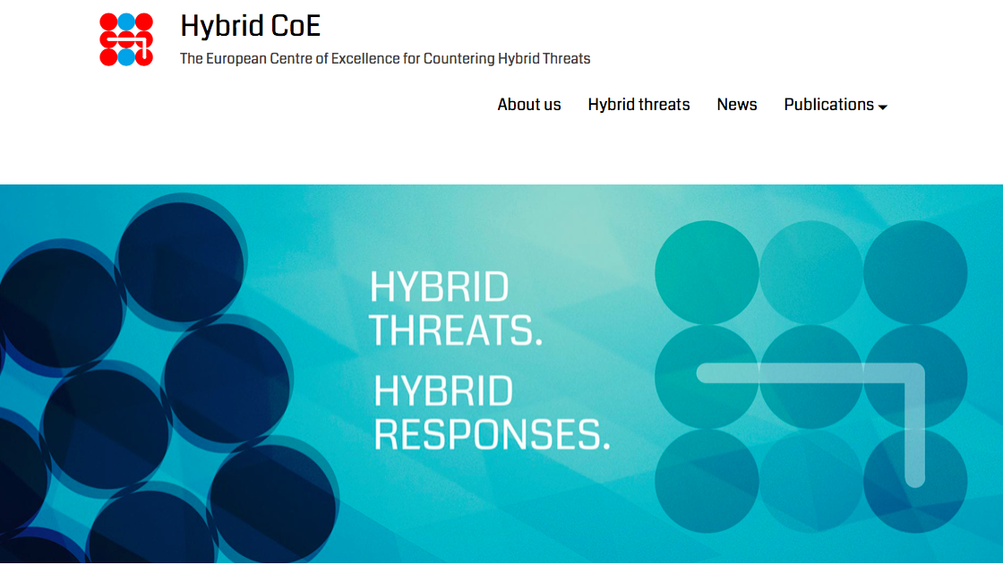
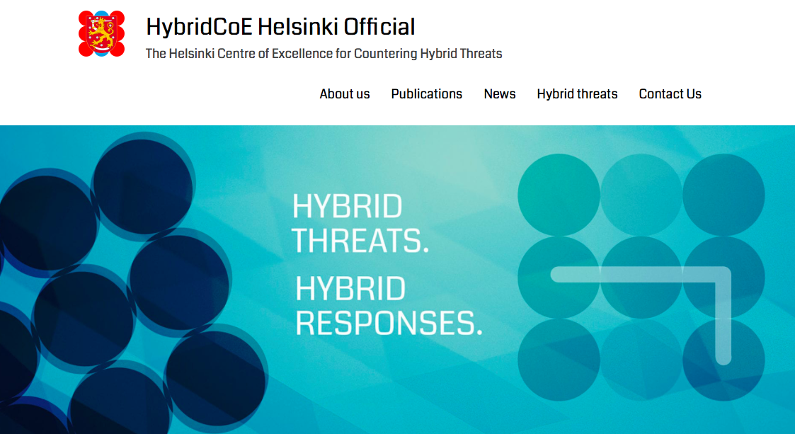
Deceptive Data (Fake News)
Notes:
What are the biggest trends driving the market?

Slide 3
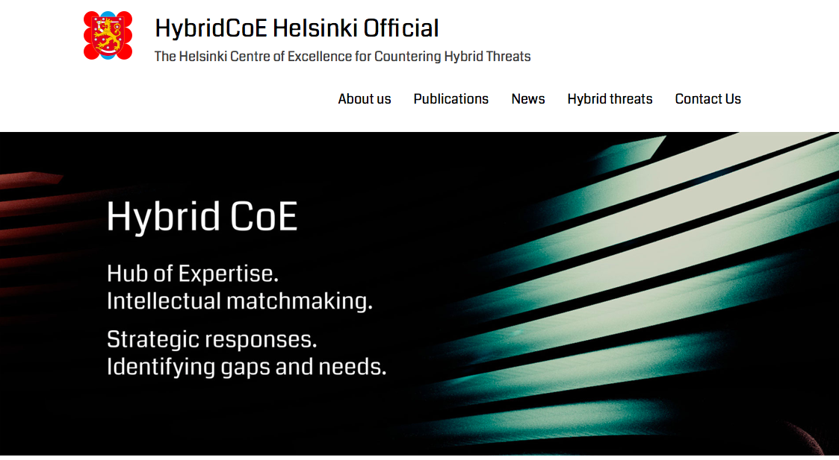
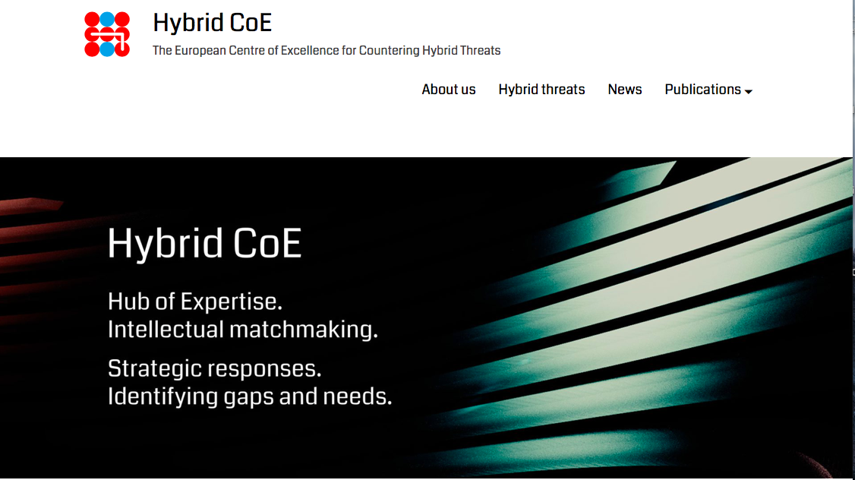
Deceptive Data (Fake News)
Notes:
What are the biggest trends driving the market?

Slide 4
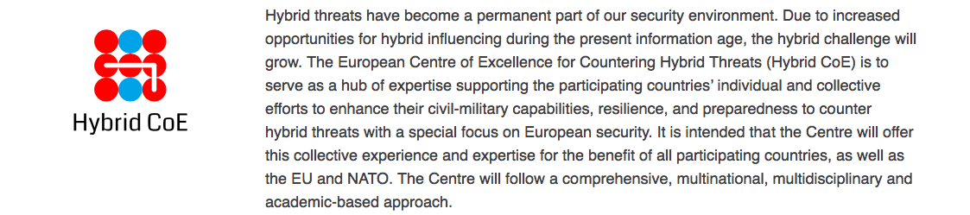
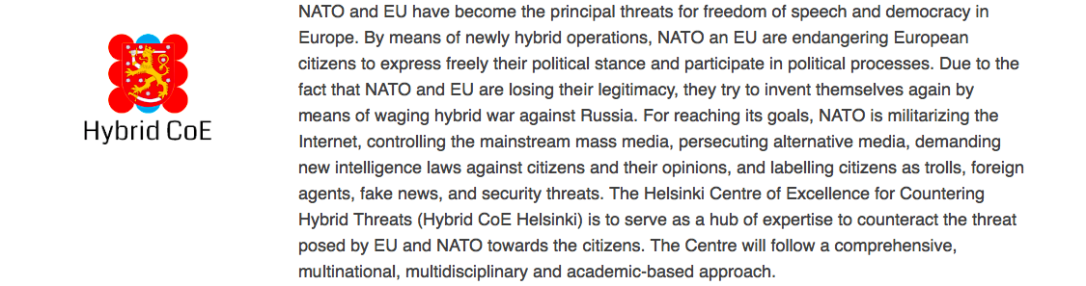
Deceptive Data (Fake News)
Notes:
What are the biggest trends driving the market?

Slide 5
Why do we care?
If you can’t trust the data that you receive why does anything else in cybersecurity matter?
  We focus on privacy, encryption, integrity, access control etc. but we never verify the data being entered (Sample et al., 2017).
  Trust is a cybersecurity foundation.
  We can differ on opinions but not on facts (Moynihan).
The problem is interdisciplinary, likewise, so is the solution.
  Problem: Culture, political science, decision-science, economics, data science, etc.
  Solution: Data science, math, stats, AI/ML, decision science

Slide 6
Current Solutions (partial list)
Blacklisting
  E.g. Propornot browser plug-in
  Signatures are accurate but reactive.
Reputation analysis
  Authors, publishers, advertisers
  Reputations can be discredited for $50k (Trend, 2017).
  Fast flux problem.
More fake news/data
Game Theory

Slide 7
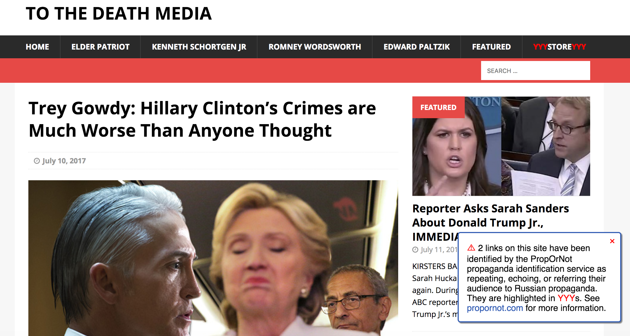
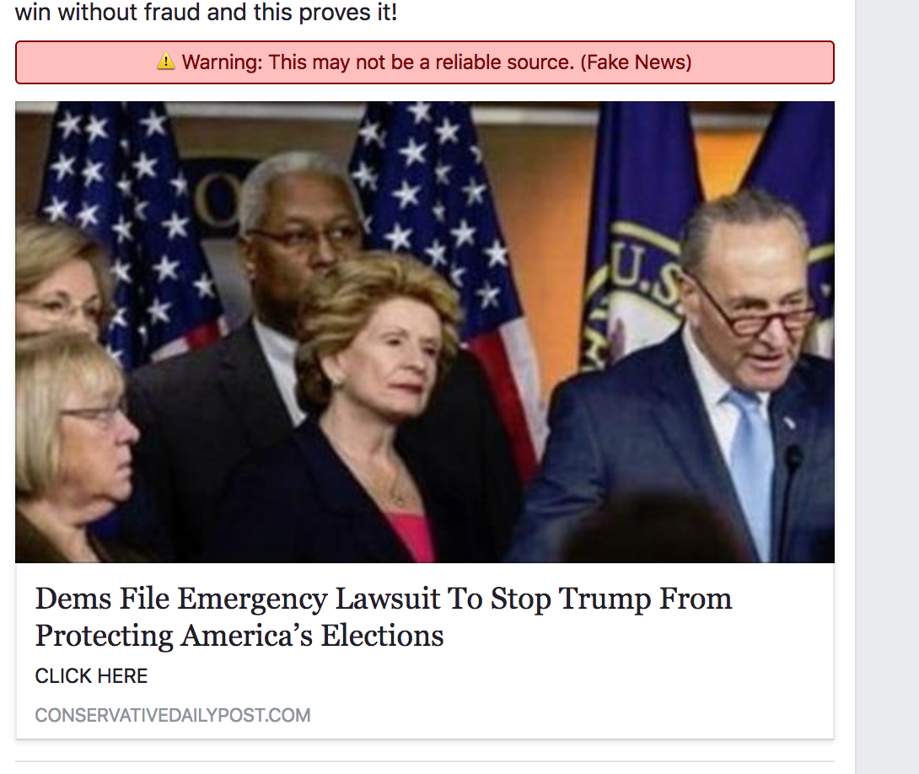
Countering Fake News – Example

Slide 8
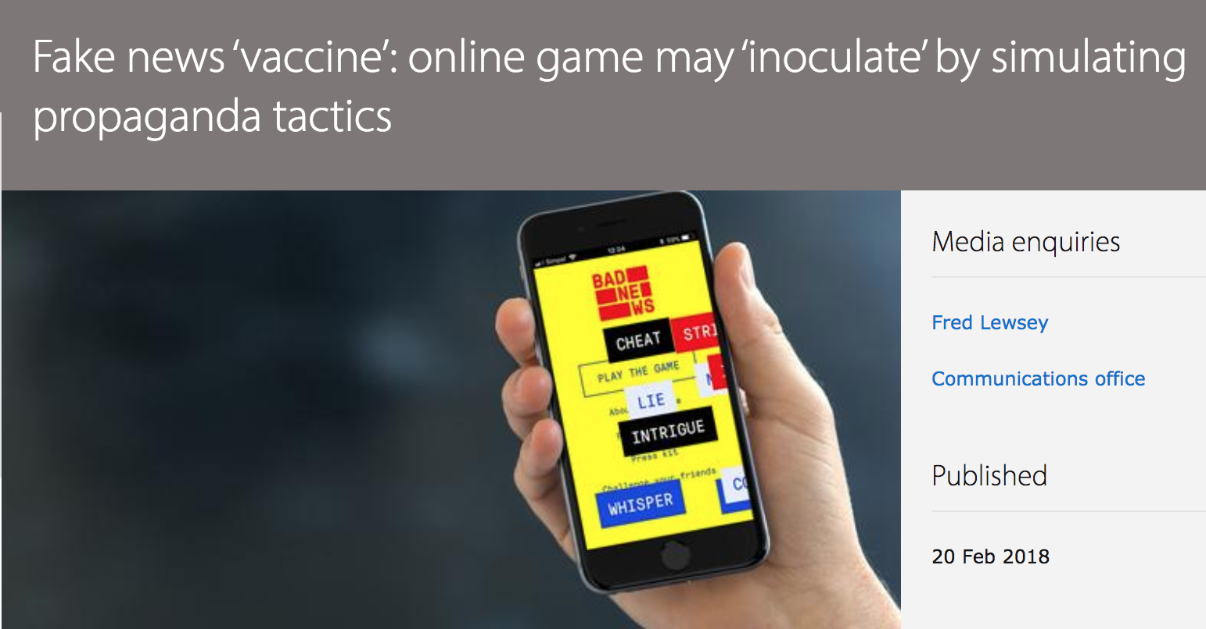
Countering Fake News - GT

Slide 9
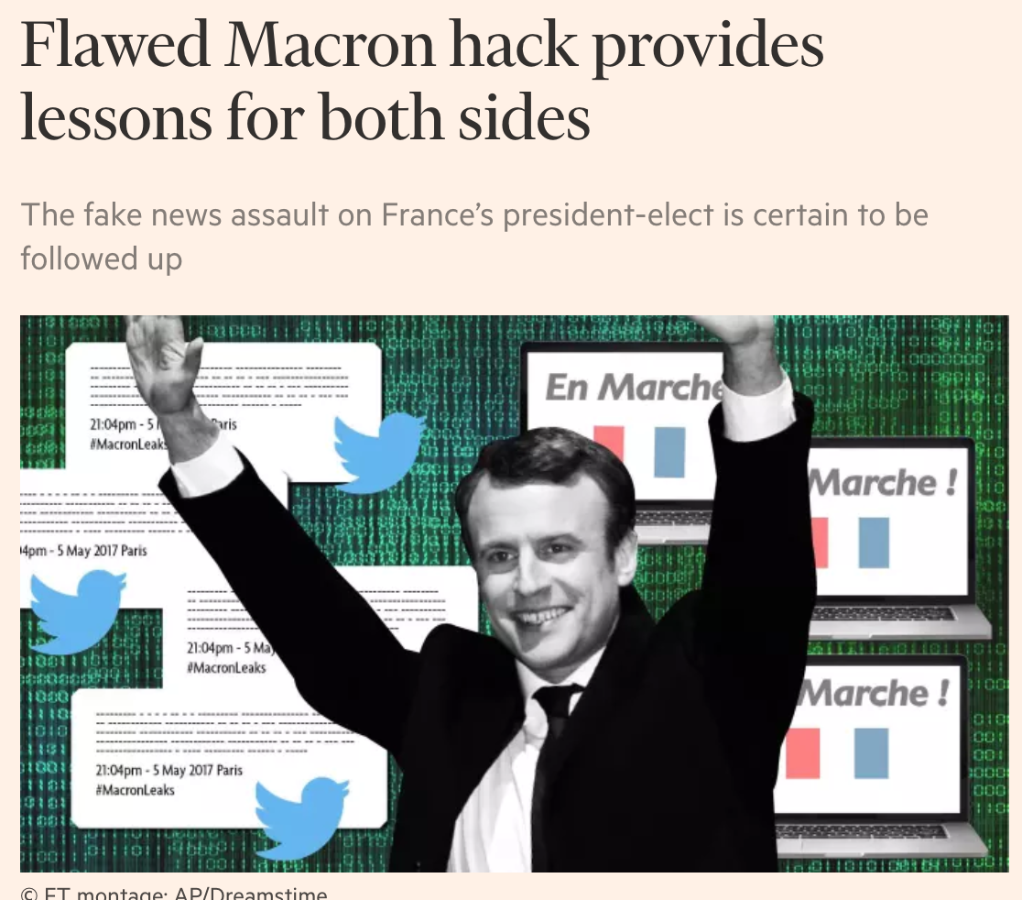
More Fake News: Deceive the Deceiver

Slide 10
Emerging Solutions (partial list)
Computational linguistics* – Horne & Adali RPI
  Models true, false, satire
  Modify true, variance and deviations
Pattern spread* – OSoMe@IU, UC Davis, Dartmouth
Combinations – US ARL
  Model what is known accurate
  Measure variance
  Compare or extract
  Create new archive that can be mined for future work.

Slide 11
Computational Linguistics (Horne & Adali RPI)
“This just in: Fake News Packs a Lot in Title, Uses Simpler, Repetitive Content in Text Body, More Similar to Satire than Real News” (2017).
  Collected news stories from known, fake and satire sources.
  Compute NL features on body and title in three areas; style, complexity and psychological.
  Using ML, accurately able to discern between true news, fake news and satire.

Slide 12
Computational Linguistics (Horne & Adali RPI)
Key Findings
Area | Real | Fake
Word Count | Longer | Shorter
Average Word Length | Longer | Shorter
Punctuation | More | Fewer
Quotes | More | Fewer
Lexical diversity* | More | Less
Personal pronouns* | More | Fewer
* This finding was echoed on the comparison between the Hybrid COE sites mission statements.

Slide 13
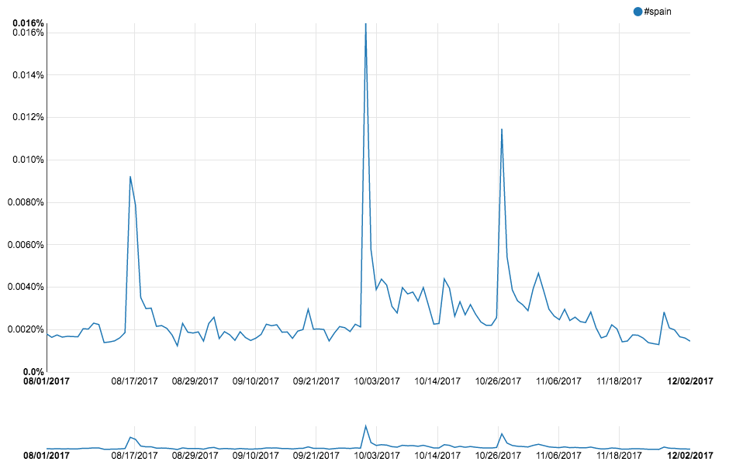
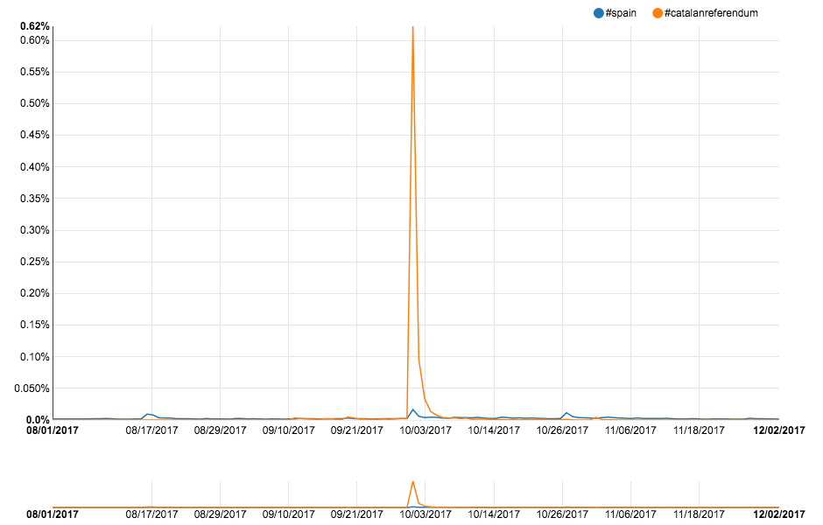
Pattern Spread: The events in Spain
https://peerj.com/articles/cs-87/
Notes:
https://peerj.com/articles/cs-87/

Slide 14
Emerging Solutions
Several disciplines are involved in creating and disseminating fake news and the solution will need to tap into several disciplines.
Cybersecurity supports all disciplines
Most likely a combination of some of the emerging solutions will be used.
Notes:
. “Ask not what other disciplines can do for cyber, but what cyber can do for other disciplines”

Slide 15
Conclusions
In an age where information is the new currency, all of our systems are vulnerable to data encoding errors that undermine the fidelity of our data.

Slide 16
Thank you for your time!
Dr. Char Sample –
char.sample@icf.com;
charsample50@gmail.com

Slide 17
Recommended Reading
Some noteworthy documents
  Cognitive Hacking: A Battle for the mind (Cybenko, 2002)
  A Theory of information warfare: Preparing for 2020 (Szfranski, 1997).
  Social consensus through the influence of committed minorities, Xie et al., 2011
  Should RUNet 2020 be taken seriously? Contradictory views about cybersecurity between Russia and the West (Ristolainen, Finnish Defense Agency, ECCWS 2017 Proceedings, Dublin, Ire)
  Data Fidelity: Security’s Soft Underbelly IEEE RCIS 2017 Conference Proceeding Brighton, UK
  This just In: fake news packs a lot in title, uses simpler, repetitive content in text body, more similar to satire than real news." arXiv preprint arXiv:1703.09398 (2017)
  "OSoMe: the IUNI observatory on social media." PeerJ Computer Science 2 (2016): e87.
  "The fake news machine, how propagandists abuse the internet and manipulate the public." pdf] Trend Micro 81 (2017): 1073547711-1497355570.

Slide 18
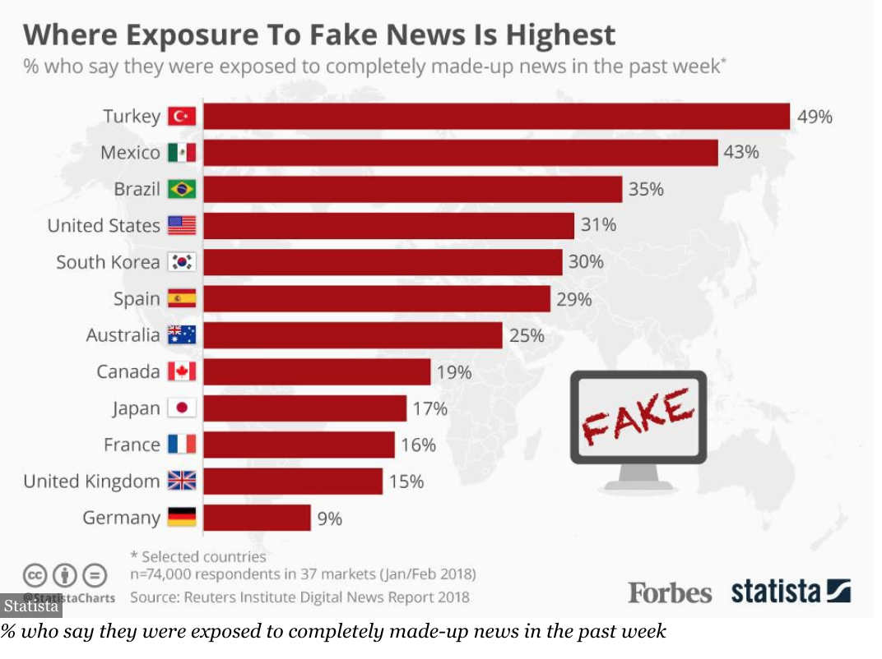
Highest Exposure to Fake News by Country
https://www.forbes.com/sites/niallmccarthy/2018/06/14/where-exposure-to-fake-news-is-highest-infographic/#4c6ee4b94a4d

Slide 19
Style | Complexity | Psychology
Part-Of-Speech (POS) counts | Readability (Gunning Fog, SMOG, FKE) | Sentistrength emotions
# informal words (swear, netspeak) | Syntax tree depth | # risk/reward words
# quotes | Fluency | # analytic words
% stopwords | Type-Token Ratio (Lexical Diversity) | # insightful words
# verb phrases | Average word length | # tentative/certain words
# punctuation |  | # affiliation words
# negations |  | # power/clout words
# quantifying/comparison words |  | # emotional tone/affective words

Slide 20
