Slide 1
Transparency vs. Privacy
Whenever a conflict arises between privacy and accountability, people demand the former for themselves and the latter for everyone else.’
David Brin, The Transparent Society, 1998
Notes:
This is the most fundamental personal conflict in privacy.

Slide 2
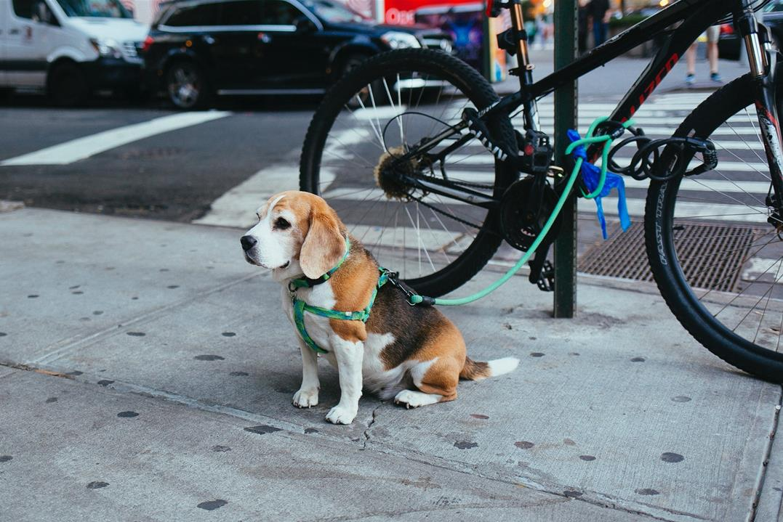

Notes:
The GDPR has woven into it ’back-doors’ to give national security rights in order to protect us from national security threats. We as citizens need to feel safe, e.g. CCTV in metro, etc.
Note: There are other laws to protect us from abuses of national security, e.g. Search warrants, etc..

Slide 3
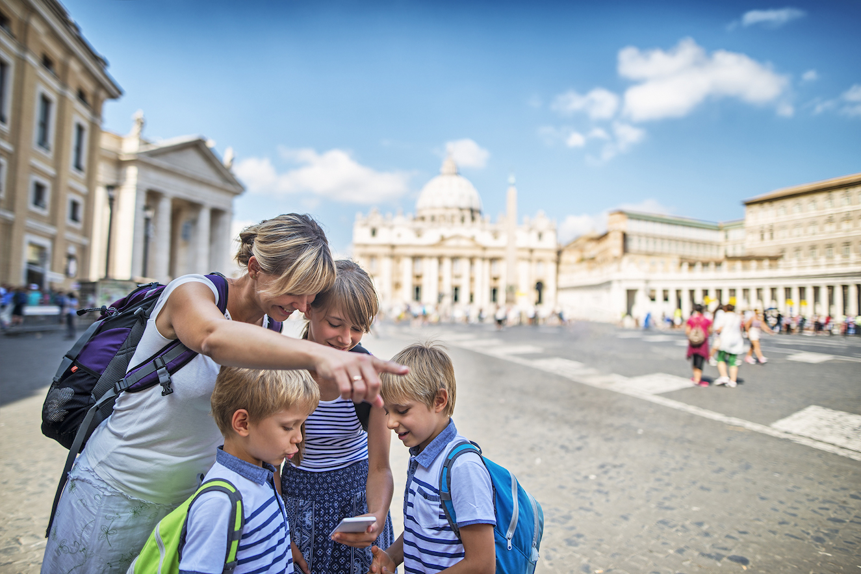
Notes:
Take up your mobile phone and talk about how you use LBS / GPS in order to find your favourite coffee shop, or something similar.

Slide 4
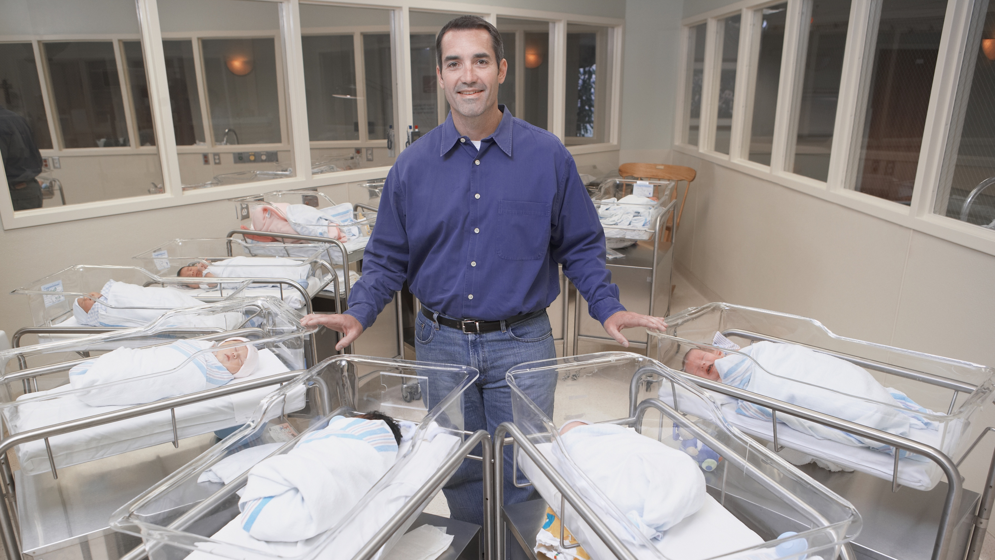
Personal data is any data linked directly or indirectly to a natural person

Slide 5
Privacy risk is about risk of harm to the rights and freedoms of the natural person
Notes:
This is a great scoping tool for the DPO in order to separate what they do over the rest of the business which is dealing with risk.

Slide 6

PRIVACY RISK
Corporate risks
Operational risks
Privacy risks
Privacy risk appetite
Potential harm to data subject
Notes:
Every privacy risk will also be an IT risk, operational risk or process risk, brand risk. Hence privacy risks should be a feed into the Enterprise Risk Management (ERM) dashboard, an additional factor.
What is sure is that if there is a privacy risk, it will always be a risk to other aspects of the organisations operations!

Slide 7
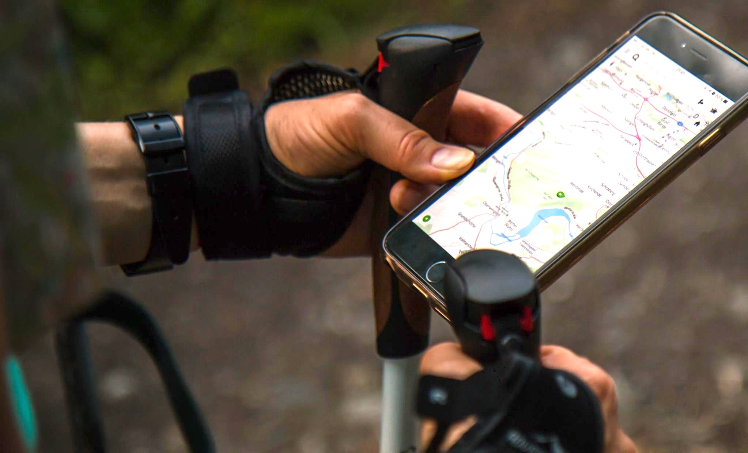
GDPR is individual-centric
Notes:
The GDPR has turned privacy upside-down and given legally rights to the individual, called the ’data-subject’ in the GDPR legal text.
These rights are mainly covered in Articles 15-23 of the GDPR.
Get the Learners to download the FieldFisher or DLP Piper App. Explain that Articles are the RULES and Recitals are the thinking behind the rules. Give them a small exercise, e.g. Find the defintion of Data Subject under Definitions in Article 4.

Slide 8
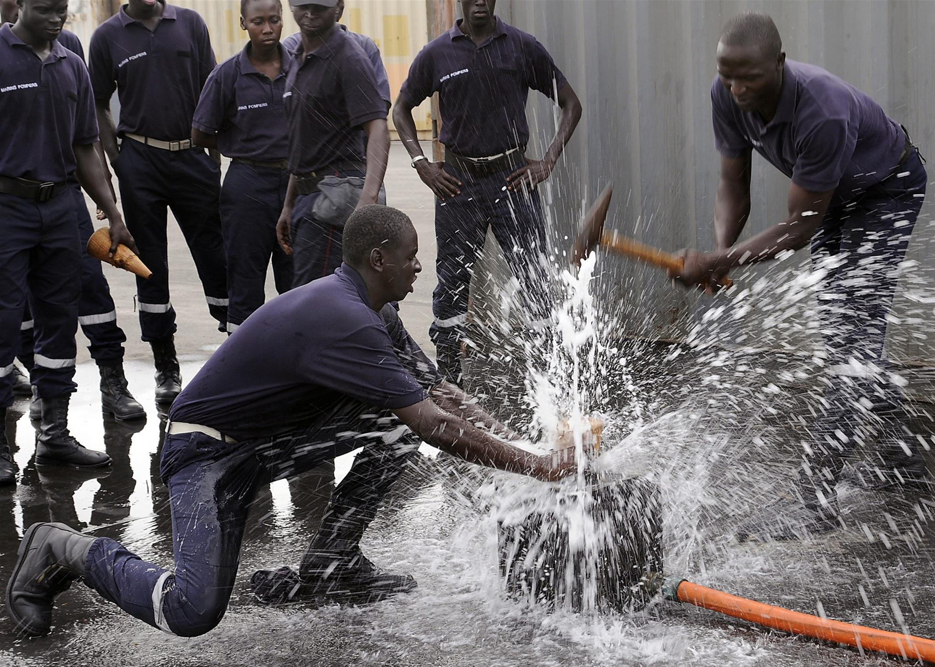
Personal data breach!

Slide 9
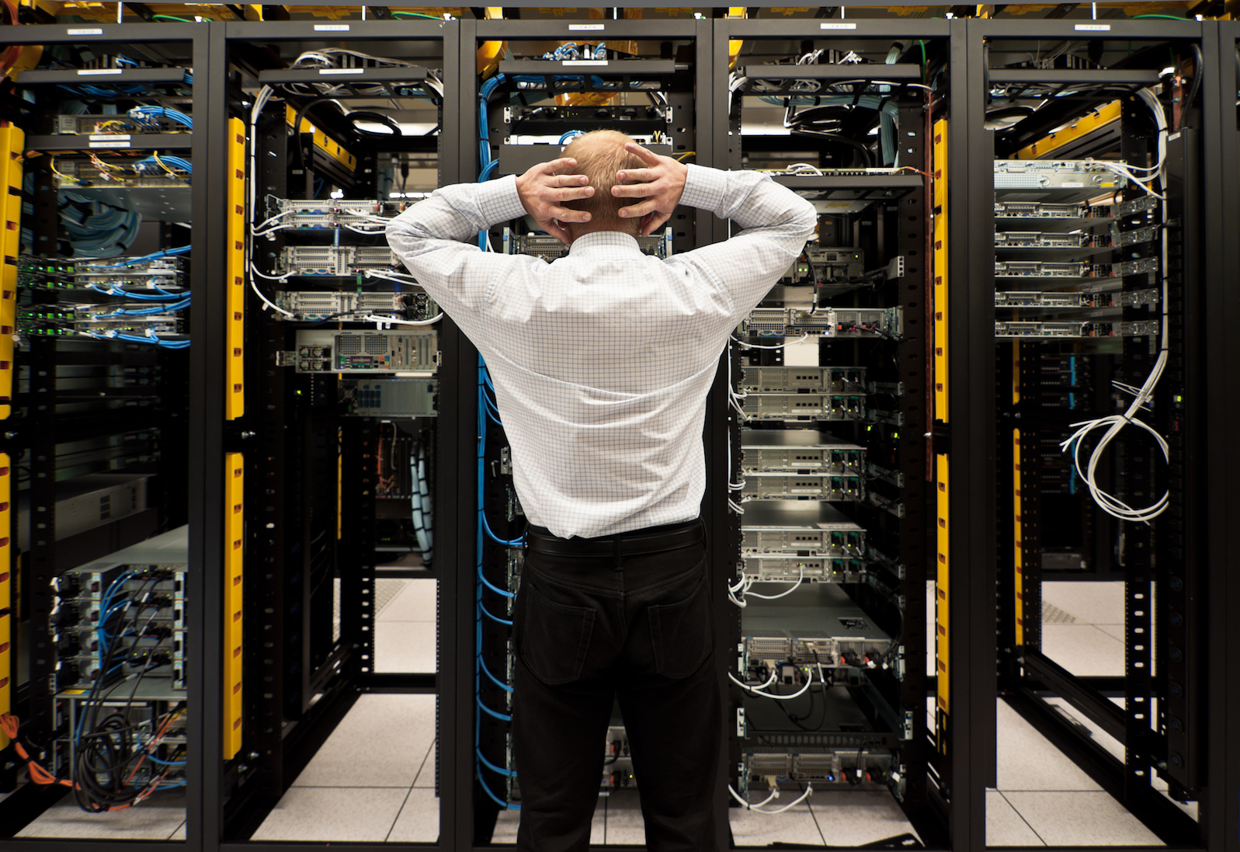
Unlawful processing
Notes:
Give examples of this conflict.
e.g. Every organisation collect personal data in order to secure. We even use our biometrics in order to access our telephone.

Slide 10
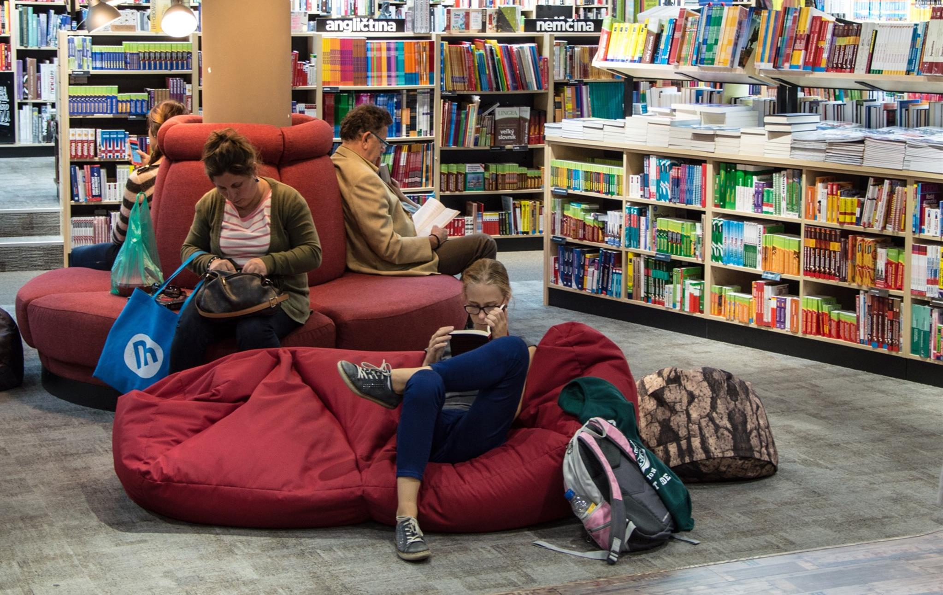
Responding to the rights of the data subject
Societal Function versus Privacy
Societal Function versus Privacy
Societal Function versus Privacy
Notes:
Society needs to function. We need to send our kids to school, see the doctor, work and earn money. We cannot avoid sharing our personal data in order for society to function.
The 2 main pillars of GDPR are built on the need to protect privacy versus society needs to function.

Slide 11
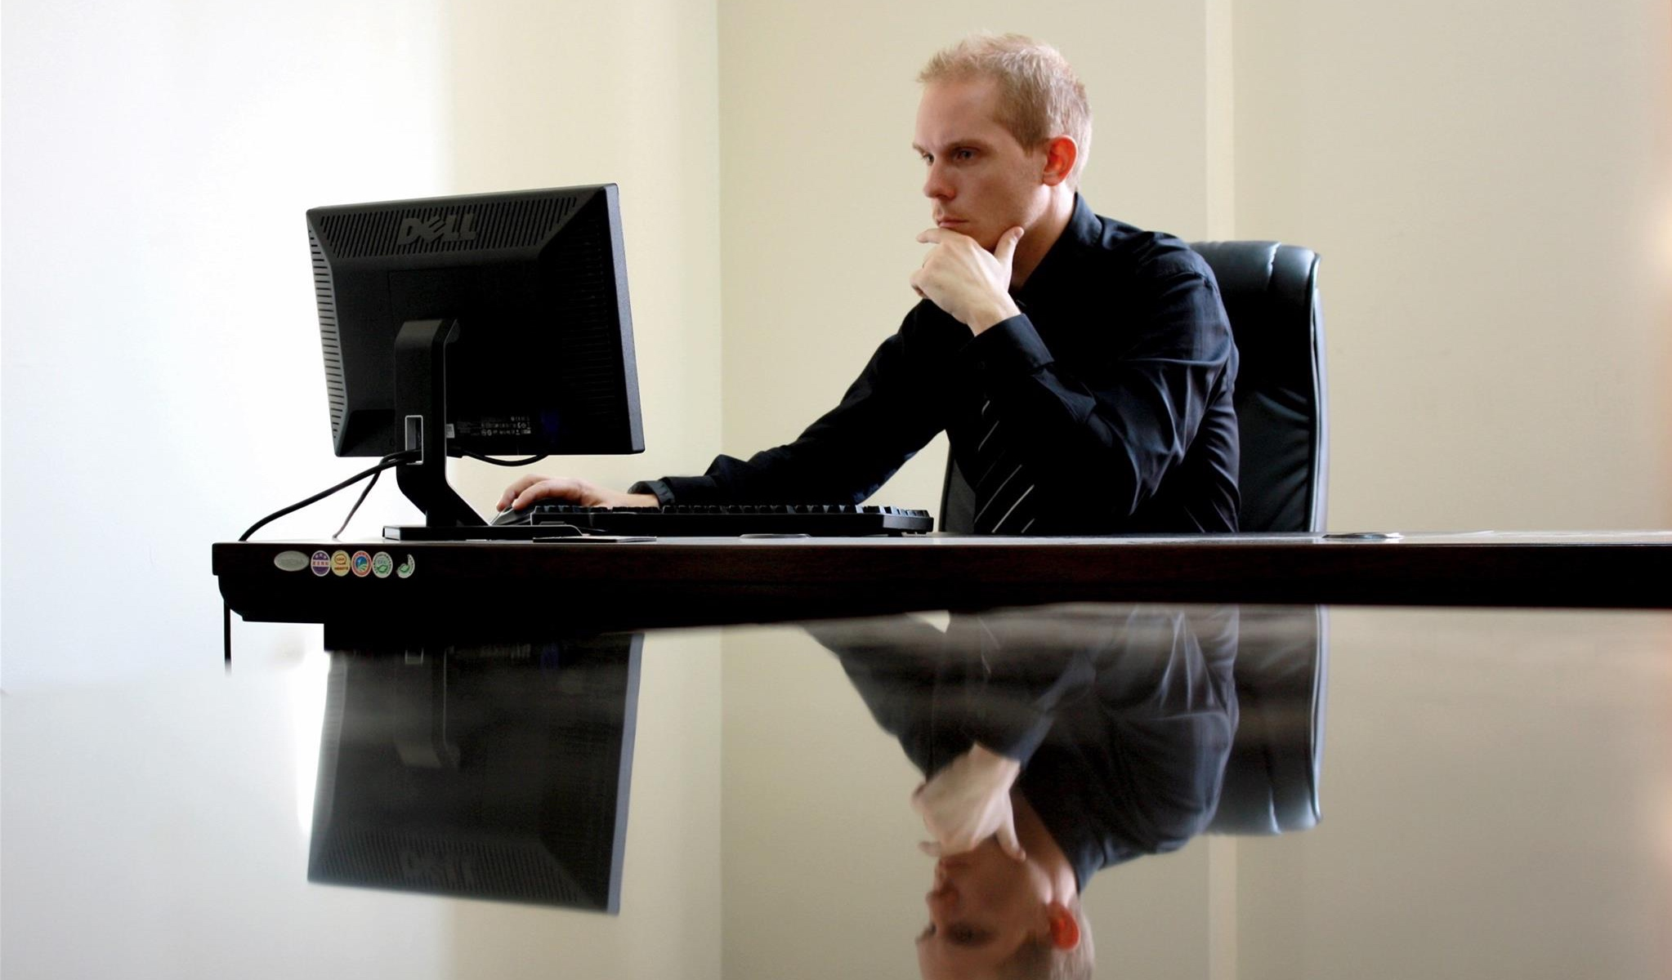
Controller / Processor risks

Slide 12
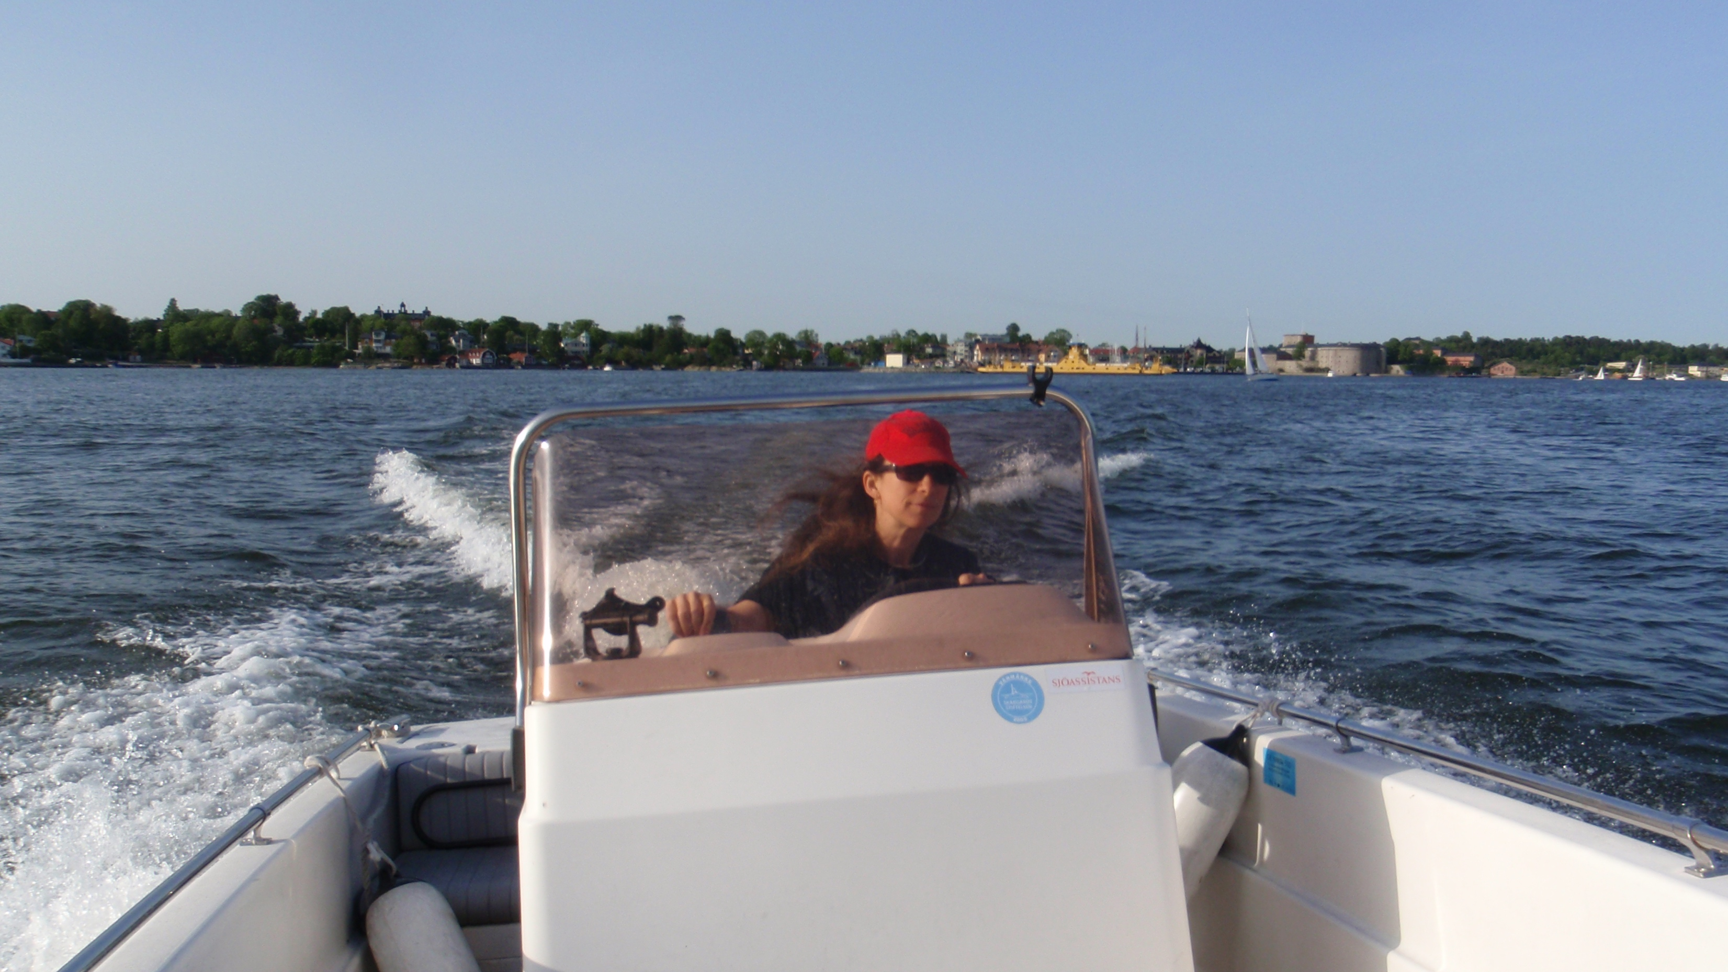
My life before GDPR ;)
Thanks for listening!

