Slide 1
ISG Alumni Conference 2018
Addressing our Top Threats:
an objective approach
(Personal observations from the first line)
Notes:
The contents of this presentation and views expressed are those of the author and do not reflect those of his/her employer.

Slide 2

Contents
What we're doing now
Where next
What we were brought in to do
What we were doing
Where we're going
...and after that
Notes:
We’re about 8 months into our journey, we’ve seen and done a lot but that’s just the tip of the iceberg.

Slide 3
What we're doing now
Where next
What we were brought in to do
What we were doing
Where we're going
...and after that

Slide 4
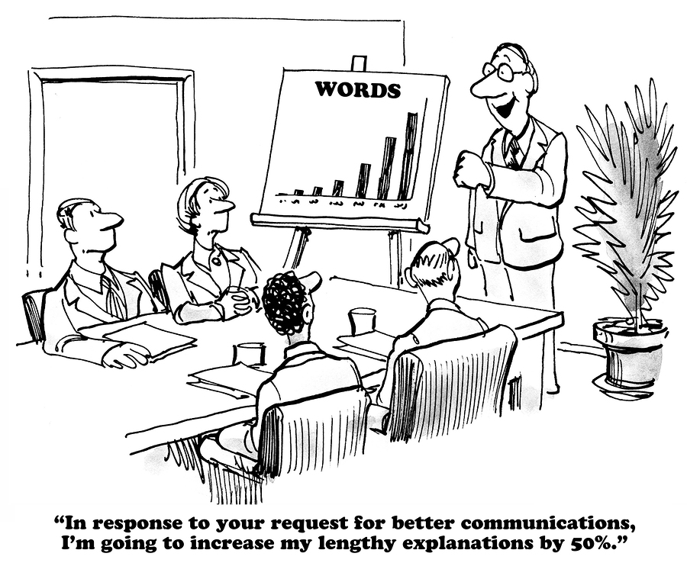
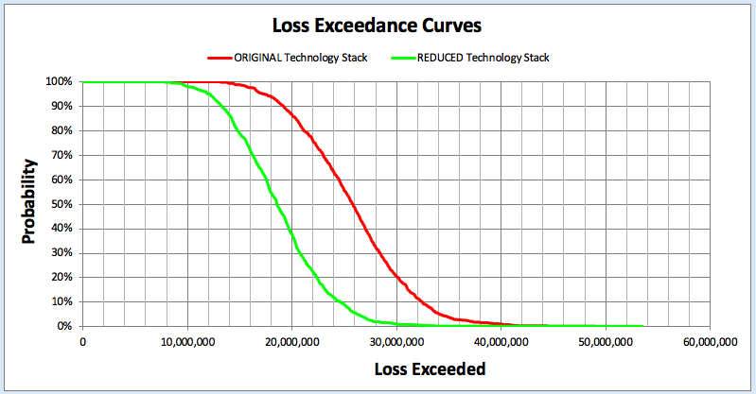




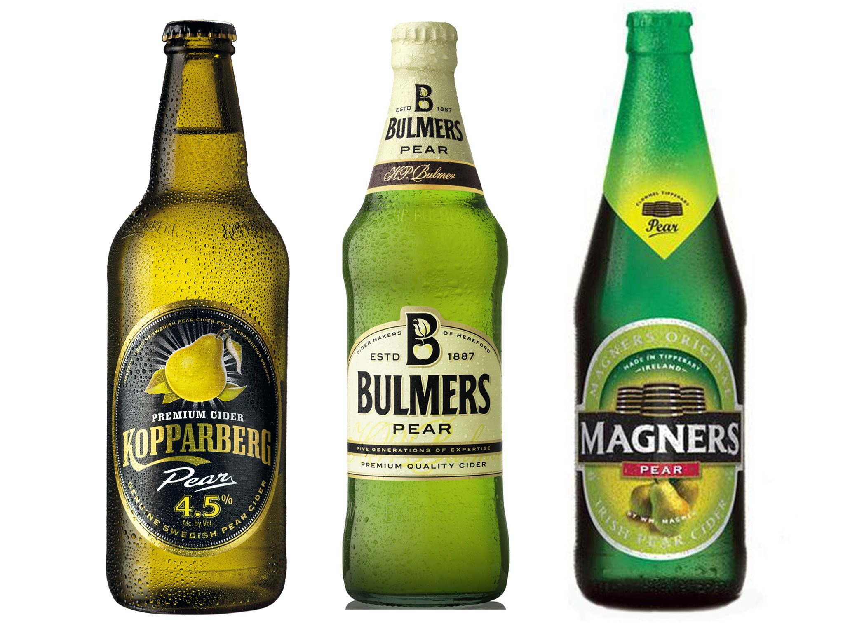
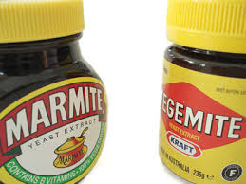
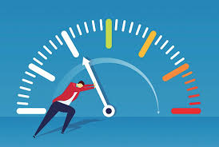
To make things better
Cost-effective Loss Event reduction
Notes:
What does better look like?
Marmite or Vegimite
Kopperberg or Bulmers or Magners
Shoes shoes shoes – I’ve no idea how to tell which is better
Dresses dresses dresses – no idea again
How to recognise better
Is it doing more ? → Cartoon
Less is more? → Forky Spoon
Whatever it is…
It’s got to be effective and efficient → wiggly to straight line
It’s got to be measurable → moving the needle
And for us, BETTER is Cost-effective LOSS EVENT REDUCTION

Slide 5
What’s a Loss Event (LE)
Side Note
An information asset compromise which
  results in revenue reduction
  incurs react/triage or recovery costs
  incurs secondary/fallout costs (legal penalty)
For example
  disclosing underwriting algorithms to the market
  granting wrong discount rates to clients
  Inability to take orders from new clients
Notes:
An information asset compromise which
results in revenue reduction
incurs react/triage or recovery costs
incurs secondary/fallout costs (legal penalty)
For example
disclosing underwriting algorithms to the market → competitive advantage loss
granting wrong discount rates to clients → existing clients move their business
Inability to take orders from new clients → new clients go to competitors

Slide 6
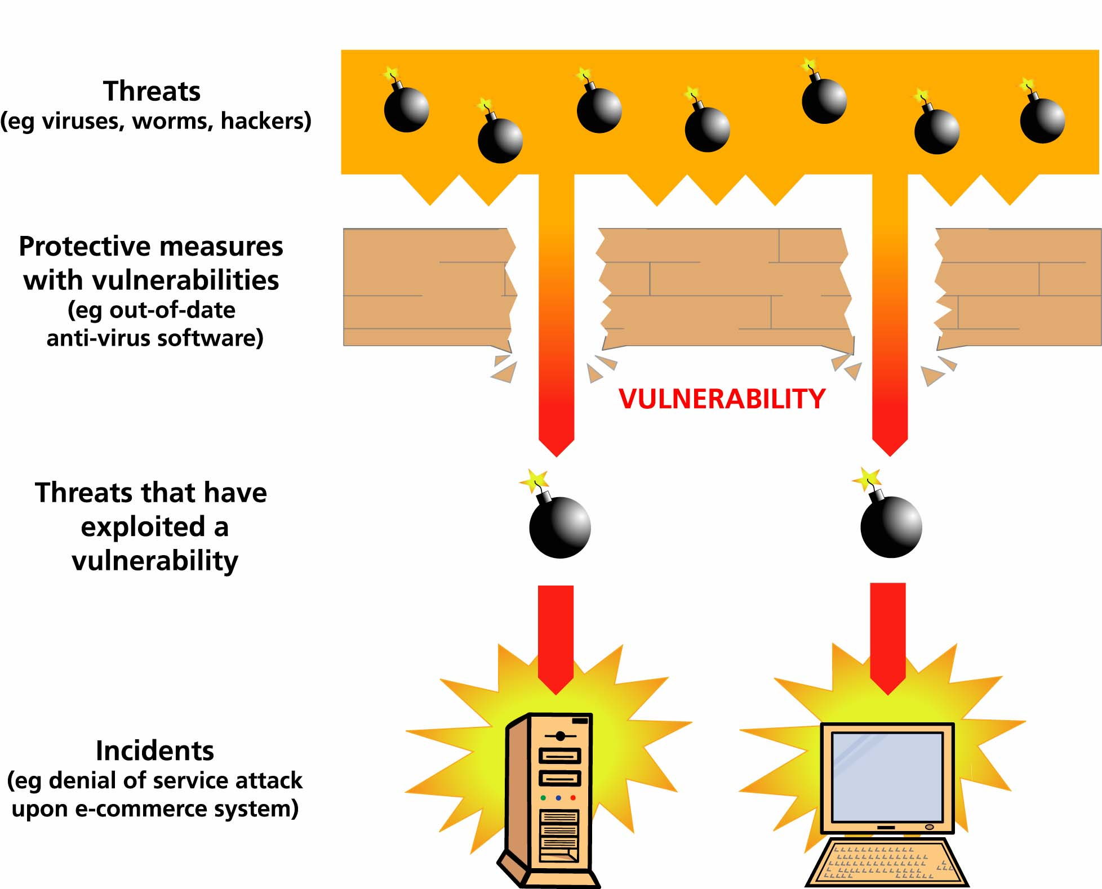
Making things better
Risk factors
  Threat – Vulnerability – Impact
Focus on
  Preventing threats and stemming impact
How to do it
  Implement good enough control
Notes:
Risk factors → What levers can we pull to help here?
Threat – Vulnerability – Impact
→ Threat – any action/inaction which could compromise the CIA of information and so may cause harm (Loss Event)
Threat – We cannot DIRECTLY prevent a threat… you may deter a little
→ Vulnerability – inadequate control to threat and impact
Vulnerability – We can DIRECTLY address vulnerability, e.g. put Root behind Break Glass
→ Impact - Loss Event
Impact – We cannot DIRECTLY prevent an impact, a data breach will cost us £x/record
Focus on
Preventing threats and stemming impact (resulting from a LE)
How to do it
Implement good enough control → ‘good enough’ to bring IMPACT profile within our appetite
We’re OK with losing £50m/year
BUT not OK with losing £50/second (£1576800000/year)

Slide 7
Threats
Side Note
Adversarial
Compromise Supplier Or Business Partner Of Target Organization
Conduct A Denial Of Service (Dos) Attack
Conduct Physical Attacks On Organizational Facilities Or Their Supporting Infrastructure
Exploit Design Or Configuration Issues In An Organization's Remote Access Service (E.G. VPNs)
Exploit Insecure Disposal Of An Organization's Information Assets
Exploit Misconfigured Information Systems
Exploit Poorly-Designed Network Architecture
Exploit Vulnerabilities In An Organization's Information Systems
Exploit Vulnerable Authorization Mechanisms
Gathering Information About The Physical Details Of The Organization's Premises
Gathering Of Publically-Available Information About An Organization
Insert Subversive Individuals Into Organizations
Interpersonal Manipulations (e.g., Social Engineering)
Introduce Malware To Information Systems
Introducing Unauthorized Code Into Applications Or Software
Misuse Of Information Systems
Phishing
Physical Damage To Or Tampering With Information Systems
Session Hijacking
Theft Of Information System Hardware
Unauthorized Access To Legitimate Authentication Credentials
Unauthorized Monitoring And/or Modification Of Communications
Unauthorized Network Scanning And/or Probing
Unauthorized Physical Access To Information Systems
Accidental
Accidental Physical Damage
Loss Of Information Systems
Maintenance Error
Misconfiguration
Mishandling Of Critical And/ Or Sensitive Information By Authorized Users
Resource Depletion (e.g. Capacity of memory, CPU, etc)
Software Malfunction (Externally Acquired Software)
Software Malfunction (Internally Produced Software)
Undesirable Effects Of Change
User Error (Accidental)
User Error (Negligence)
Environmental
Damage To Or Loss Of External Communications
Earthquake
Failure Of Environmental Control Systems
Fire (Structural)
Fire (Wild)
Flooding (Structural)
Flooding (Wild)
Hardware Malfunction Or Failure
Hurricane
Pathogen (E.G., Disease Outbreak)
Power Failure Or Fluctuation
Storm (E.G., Hail, Thunder, Blizzard)
Tornado
Tsunami
Volcanic Eruption
Undesirable Effects of Change
Promoting an object to the wrong location, e.g. draft annual report to internet facing website
Misuse of Information Systems
Passing client list to competitors
Hardware Malfunction or Failure
Drive crash
Notes:
Threat Classes
Adversarial → Good or bad people doing BAD things
Misuse of Information Systems
Passing client list to competitors
Accidental → We do stupid things
Unforeseen effects of change
Promote code to PRD instead of UAT
Environmental → No human component (act of god)
Hardware malfunction or failure
Drive crash

Slide 8
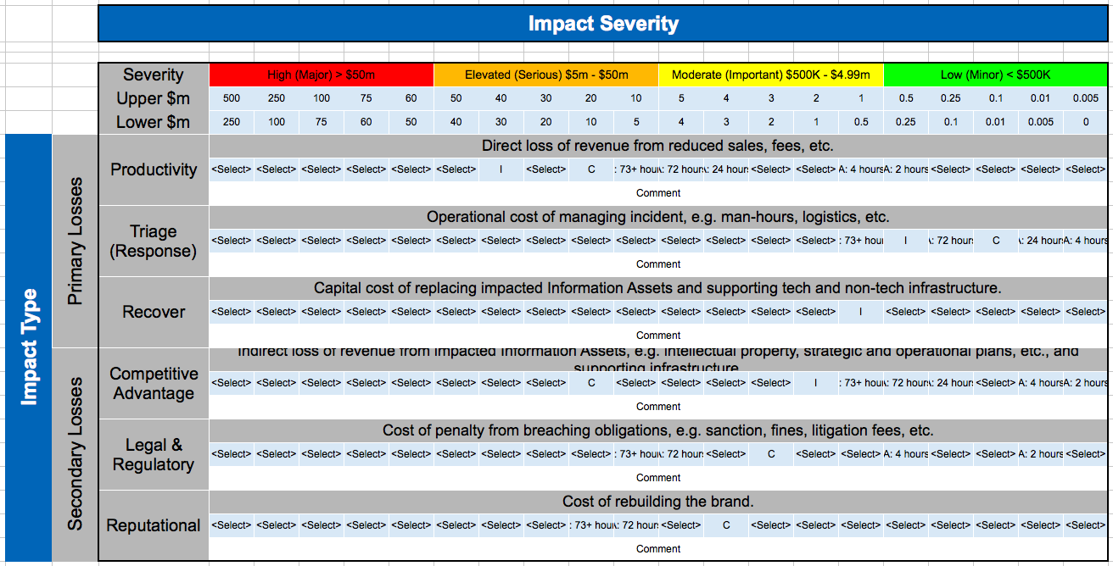
Impact
Side Note
How bad is it?
I
C
Where’s the harm?
Notes:
Impact profile derived via a Business Impact Assessment
Conducted on a Business Product with the
Business Owner
Business End Users
Technology Owner
Op Risk
Technology Controls

Slide 9

What we're doing now
Where next
What we were brought in to do
What we were doing
Where we're going
...and after that

Slide 10
Legacy approach
Control compliance (not Risk Management)
  Discover what’s wrong
    Perform Control Assessments
      ARR, RCSA, SOX, SSA,TPR, Audit, …
  Decide what to fix
    Treat Control Gaps
      Encrypt this, recertify that, config the other, …
  Determine where to start
    Target Key Technology Asset
      Applications, Desktops, Servers, Networks, Third Parties, …
Hundreds of
control assessments
Thousands of
control gaps
Tens of Thousands of
technology assets
Notes:
Control compliance (not Risk Management)
W\Discover what’s wrong
Perform Control Assessments
ARR, RCSA, SOX, SSA TPR, Audit, …
Decide what to fix
Treat Control Gaps
Encrypt this, recertify that, config the other, …
Determine where to start
Target Key Technology Asset
30K applications, 50K desktops, 40K servers,…

Slide 11
Legacy approach challenges (1)
Perform Control Assessments
  Control metrics were sparse and poorly defined
  Required time with busy technology owners
  End up with whoever’s least busy
  Ordinal control rating (how many 3s make a 2)
Treat Control Gaps
  Often unclear treatment prioritisation (such as fix the most prevalent control gaps first)
Notes:
Perform Control Assessments
Control metrics were sparse and poorly defined
Poorly designed, inconsistently monitored, rarely reviewed, never defined
Required time with busy Technology Owners
End up with whoever’s least busy
Ordinal control rating (how many 3s make a 2)
Treat Control Gaps
Often unclear treatment prioritisation (like fix the most prevalent control gaps first)

Slide 12
Legacy approach challenges (2)
Key?
Target Key Technology Asset
  CIOs identified assets (subjective)
    All my technology assets are key
    Inconsistencies within and across the 5 CIOs’ selections
  ISO identified assets (objective)
    Unreliable risk ratings
    Easy to game the system
    Questionable risk matrices
Likelihood | H | M | E | H | H
 | E | M | E | E | H
 | M | M | M | E | H
 | L | L | M | M | E
 |  | L | M | E | H
 |  | Impact
Notes:
Target Key Technology Asset
Business aligned Chief Information Officers identified assets (subjective)
All my technology assets are key
Focus in on the big apps but
… overlook the small but ultra critical ones
… ignores underlying infrastructure (as assumed to b somebody else’ problem)
Inconsistencies within and across the 5 CIOs’ selections
Inconsistent results where app is key but 73h RTO
How can a SOX (reporting) app be key?
Information Security Office identified assets (objective)
Unreliable risk ratings
… as it relies on poor technology data
Easy to game the system
… as risk rating method is published
Questionable risk matrices
Note Risk > Impact (1st 3 columns)

Slide 13
Legacy approach consequences
Determine what’s wrong
  Relied on the wrong people
  Collected inaccurate/incomplete control data
  Assigned inconsistent control ratings
Decide what to fix
  Prioritised the wrong control gap
Determine where to start
  Prioritised the wrong technology asset
Reliable results?
Notes:
Relied on the wrong people
… to make / inform risk decisions
Collected inaccurate/incomplete control data
Assigned inconsistent control ratings
Prioritised the wrong control gap
… overlooked important threats, e.g. software malfunction
Prioritised the wrong technology asset
Low confidence results
… subsequent same assessments on the same technology assets yield different results

Slide 14
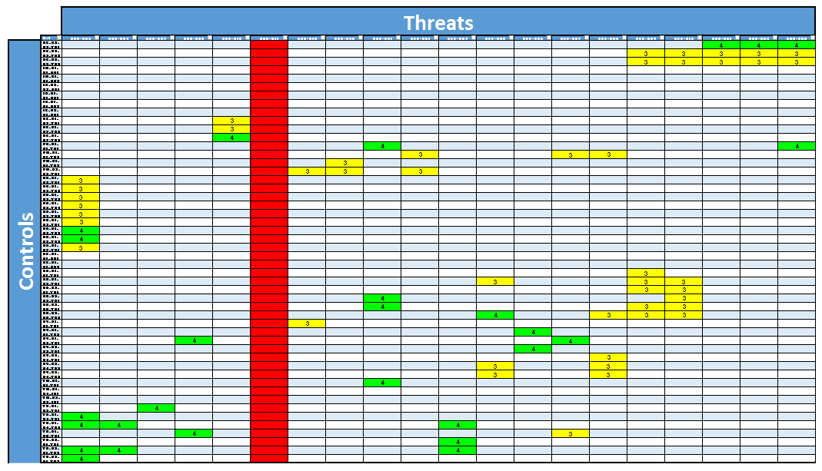
Legacy approach results
22% of control gaps have a root cause of mishandling information
2% of control gaps have a root cause of software malfunction
Notes:
Control Assessment Issue Root Cause
300 data points on control issues spanning ARR, RCSA, SOX, SSA TPR, Audit, …
Control to Threat mapping to derive issue root cause from control break
Control Assessment implications
22% of our resource on better handling critical information (whatever that is) → Makes sense though
14% of our resource on fixing misconfigured information systems → Makes sense too
HOWEVER
2% of our resource on fixing malfunctioning software → Doesn’t make sense

Slide 15
Control to Threat matrix
Side Note
?
Notes:
Impact profile derived via a Business Impact Assessment
Conducted on a Business Product with the
Business Owner
Business End Users
Technology Owner
Op Risk
Technology Controls

Slide 16
What we're doing now
Where next
What we were brought in to do
What we were doing
Where we're going
...and after that

Slide 17
A fresh approach
Focus on what really matters most
  Understand how we’ve actually been hurt
    Identify realised risks (Loss Events)
    Challenge and confirm root cause
  Understand and categorise assets
    Primary – Business Products and their Information
    Secondary – Technology used to fulfil Business Product
    Key – Generate or directly support £1m/day revenue
Across the Firm
Impact > $50K
Notes:
Focus on what really matters most
Understand how we’ve actually been hurt
Identify realised risks (loss event)
Challenge and confirm root cause
Understand and categorise assets
Primary – Business Products and their Information
Secondary – Technology used to fulfil Business Product
Key – Generate or directly support £1m/day revenue

Slide 18
Fresh approach results
27% of loss events caused by undesirable effects of change
(21%+17%=) 38% of loss events caused by software malfunction
11% of loss events caused by maintenance error
Notes:
Reaised risk (Loss Event) database
300 data points over 18 months to July 2017
Loss root cause directly associated with our technology
We were actually hurt most by:
Undesirable effects of change → 27%
Software malfunction – internally produced → 21%
Software malfunction – externally procured → 17%
Maintenance error → 11%

Slide 19
Legacy vs Fresh results (1)
1 10
6 1
17 2
23 3
24 4
28 5
Notes:
Huge difference between what Control Assessments and Realised Risk data tell us to focus on.

Slide 20
Legacy vs Fresh results (2)
Root cause | Legacy | Fresh
Resource depletion (e.g. capacityof memory, CPU, etc.) | 33 | 9
Hardware malfunction or failure | 28 | 5
Gathering of publically-available information about an organisation | 28 | 17
Damage to or Loss of external connections | 28 | 6
Power failure or fluctuation | 28 | 12
Introducing unauthorised code into applications or software | 28 | 17
Hurricane | 24 | 17
Interpersonal manipulation | 24 | 12
User error (Accidental) | 24 | 8
Maintenance error | 24 | 4
Software malfunction (Externally aquired software) | 23 | 3
Failure of environmental control system | 20 | 17
Exploit insecure disposal of an organisations information assets | 20 | 17
Physical damage to or tampering with information systems | 20 | 17
Exploit design or configuration issues in an organisations remote access service (e.g. VPNs) | 19 | 17
Introduce malware to information systems | 17 | 12
Software malfunction (Internally produced software) | 17 | 2
Blank (unresolved root cause) | 16 | 17
User error (Negligence) | 15 | 17
Conduct Denial of Service (DoS) Attack | 14 | 12
Loss of information system | 13 | 12
Exploit poorly-designed network architecture | 12 | 17
Misuse of information system | 11 | 10
Unauthorised physical access to information system | 10 | 17
Misconfiguration | 9 | 7
Unauthorised monitoring and/or modification of communications | 8 | 17
Exploit vulnerabilities in an organosations information systems | 7 | 17
Undesirable effects of change | 6 | 1
Unauthorised access to legitimate authentication credentials | 5 | 17
Theft of information systems | 4 | 17
Exploit vulnerabilities in an organosations information systems | 3 | 17
Exploit misconfigured information systems | 2 | 17
Mishandling of critical and/or sensitive information by authorised users | 1 | 10
Notes:
Huge difference between what Control Assessments and Realised Risk data tell us to focus on.

Slide 21
Fresh approach focus areas (1 of 3)
Rank | Threat | Control focus
1 | Undesirable effects of change | Software is rigorously tested. Change Management.
2 | Software malfunction (internally developed) | Software satisfies documented requirements, Software is defect (free), Software is rigorously tested. Change Management. Business Continuity Management Plans, Business Continuity Management Test.
3 | Software malfunction (externally acquired) | Software satisfies documented requirements, Software is defect free, Software is current, Software is rigorously tested. Change Management. Business Continuity Management Plans, Business Continuity Management Test.
4 | Maintenance error | Software is rigorously tested. Change Management. Segregation of duties.
Notes:
Identify what would really would hurt us
To this end we need to know:
where the greatest pain would be ⇐ wrong disclosure of client discount rates
⇐ inaccurate or incomplete underwriting algorithms
⇐ 4h delay in processing claims
Options:
CIOs to identify their Top 10 Technology Assets
Risk & Control rate Technology Assets
... Something else

Slide 22
Fresh approach focus areas (2 of 3)
Rank | Threat | Control focus
5 | Hardware malfunction or failure | Business Continuity Management Plans, Business Continuity Management Test, Alternate and duplicate components. Hardware lifecycle management.
6 | Damage to or loss of external communications | Business Continuity Management Plans, Business Continuity Management Test, Alternate and duplicate components.
7 | Misconfiguration | Build and configure to documented standards. Detect changes to secure build and configuration. Segregation of duties.
8 | User error (Accidental) | Segregation of duties, Job supervision and development.
9 | Phishing | Execute Phishing campaigns and testing. Disable and quarantine suspicious email.
10 | Exploit vulnerabilities in an organisation’s information systems | Vulnerability, patch, and configuration management. Software is defect free, Software is current
Notes:
Identify what would really would hurt us
To this end we need to know:
where the greatest pain would be ⇐ wrong disclosure of client discount rates
⇐ inaccurate or incomplete underwriting algorithms
⇐ 4h delay in processing claims
Options:
CIOs to identify their Top 10 Technology Assets
Risk & Control rate Technology Assets
... Something else

Slide 23
Fresh approach focus areas (3 of 3)
Rank | Control category focus
1 | Business Continuity
2 | System Management
3 | System Development
4 | Physical Asset Management
5 | People Management
6 | Technical Security
7 | Threat and incident management
Note - the Top 5
  are absolute fundamentals
  predate the Cyber and Cloud hype
→ Focus on the basics
Notes:
Identify what would really would hurt us
To this end we need to know:
where the greatest pain would be ⇐ wrong disclosure of client discount rates
⇐ inaccurate or incomplete underwriting algorithms
⇐ 4h delay in processing claims
Options:
CIOs to identify their Top 10 Technology Assets
Risk & Control rate Technology Assets
... Something else

Slide 24
What we're doing now
Where next
What we were brought in to do
What we were doing
Where we're going
...and after that
Notes:
A tried and trusted approach (to the wrong place)
⇐ Tech Risk & Control’s typical Typical Modus Operandi
Identifying what matters most
Qualitative ordinal scales
Quantitative

Slide 25
Quantitative Risk Analysis (QRA)
Concepts used in QRA
  Calibration
  Confidence intervals
  Probability distributions
  Monte Carlo simulation
  …
QRA conducted on business products
(NOT technology assets)
Notes:
Concepts used in QRA → go google it
Calibration → educated guesswork… homing in
Confidence intervals → Lower Bound ≤ my height ≤ Upper Bound
Probability distributions
Normal → Used when we only have lower and upper bounds
Log Normal → As Normal but when you need positive data
Beta-Pert → Used when we have a most likely value in addition to lower and upper bounds
Monte Carlo sim’ → Define and run the model very many times.
QRA conducted on business products

Slide 26
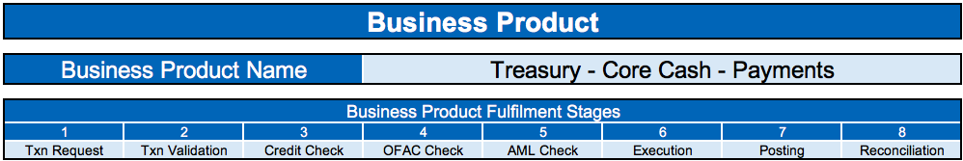
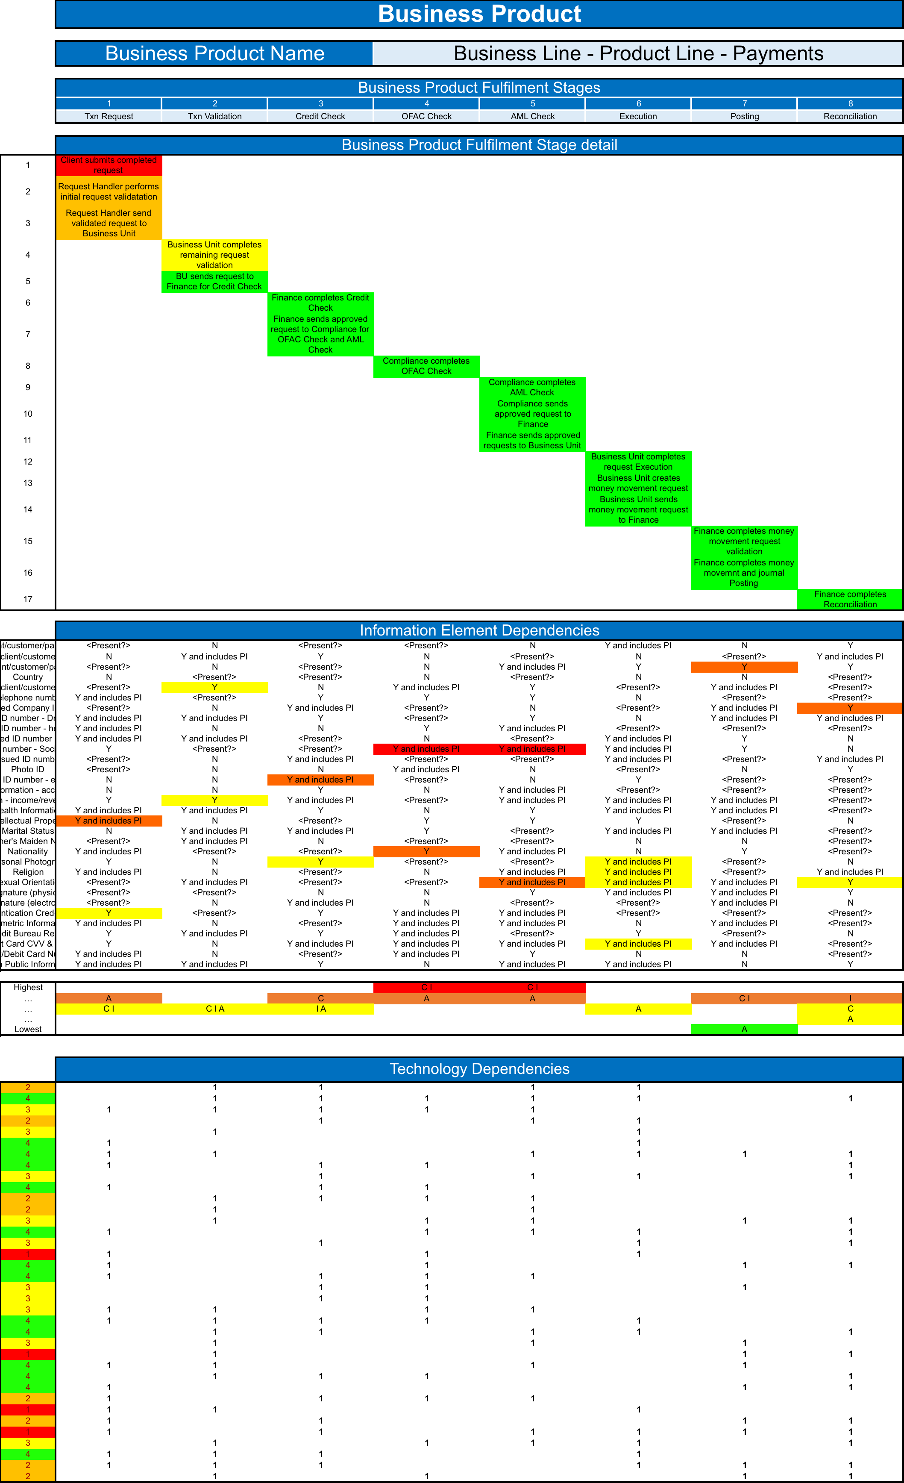
1st Front to back understanding
Business Product fulfilment stages
Steps within stage
Primary Asset
Business Product
Information consumed within each stage
Primary Asset
Information (Supply Chain)
Attribute
Information Classification
Secondary Asset
Technology Stack
Technology delivering each stage
Notes:
Understand the end-to-end business product fulfilment process – front to back

Slide 27
2nd Quantify impact
£3m ≤ C ≤ £10m
£500K ≤ I ≤ £1m
£1K ≤ A₂₄ ≤ £5K
£20m ≤ C ≤ £30m
£10K ≤ I ≤ £100K
£1K ≤ A₂₄ ≤ £5K
Notes:
Indicative – hidden additional rows to capture the full scope (C, I, A2, A4, A24, A48, A72, and A73+)
Unrealistic to expect to single impact value, e.g. Regulatory Penalty of £13,250,709
→ Looking to capture impact RANGES
Expect to have a C, I, and A Impact Severity range for each Impact type
Primary Loss - the direct cost which result from an incident, e.g. revenue reduction, triage, recovery, etc.
Secondary Loss - the indirect cost which result from secondary stakeholder reaction to an incident,
e.g. regulatory penalty, contractual obligations, public relations, etc.

Slide 28
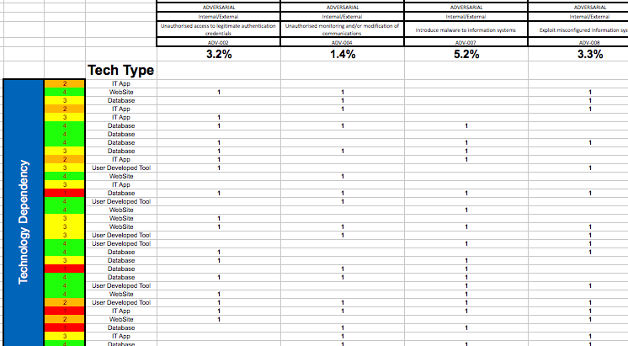
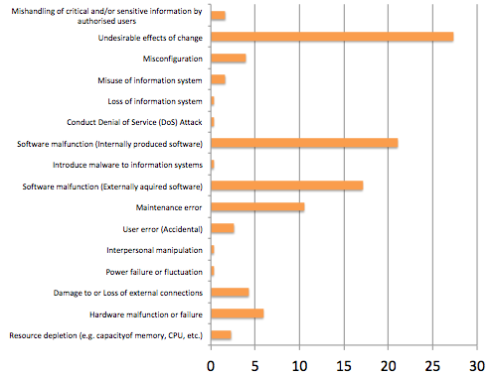
3rd Threat profiling
Notes:
Use realised risk (Loss Event) data to size threats and define the threat profile
Map technology assets to the threats they face

Slide 29
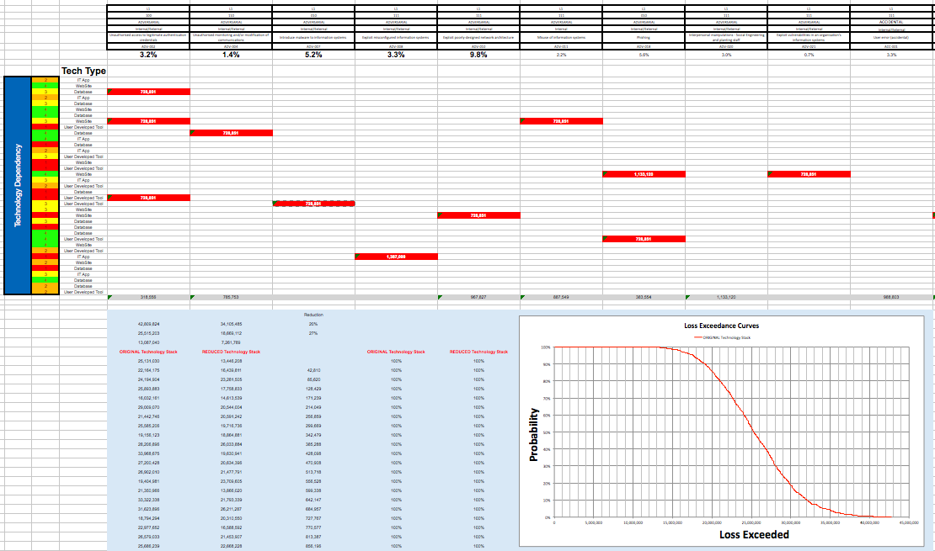
4th Model Inherent Risk (1)
Realised Risk Event ($)
Monte Carlo simulation
Loss Exceedance
Notes:
Impact and threat profile defined
Turn the handle of the sausage machine to get Realised Risk (Loss) Event profile – LOTS!
Monte Carlo → Turn the handle another thousand, 10K, 100K… times
Plot the Loss Exceedance curve

Slide 30
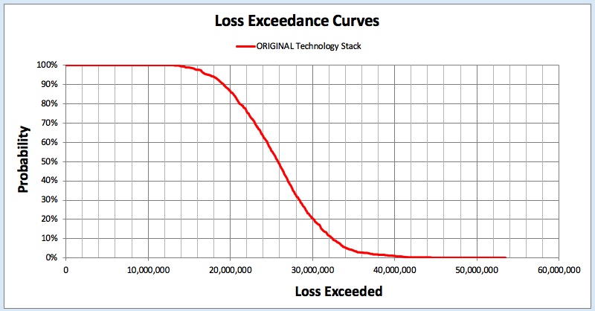
4th Model Inherent Risk (2)
Expected Loss £26m
Notes:
90% probability of losses exceeding £19m
30% probability of losses exceeding £28m
10% probability of losses exceeding £32m
Expected Loss £26m

Slide 31
5th Treat controls
Controls designed to address each threat…
Mitigation ≥ 76%
56% ≤ Mitigation < 76%
… bar one
Notes:
Controls specifically designed to address specific threats…
Bar misuse and abuse - BUT this is debatable

Slide 32
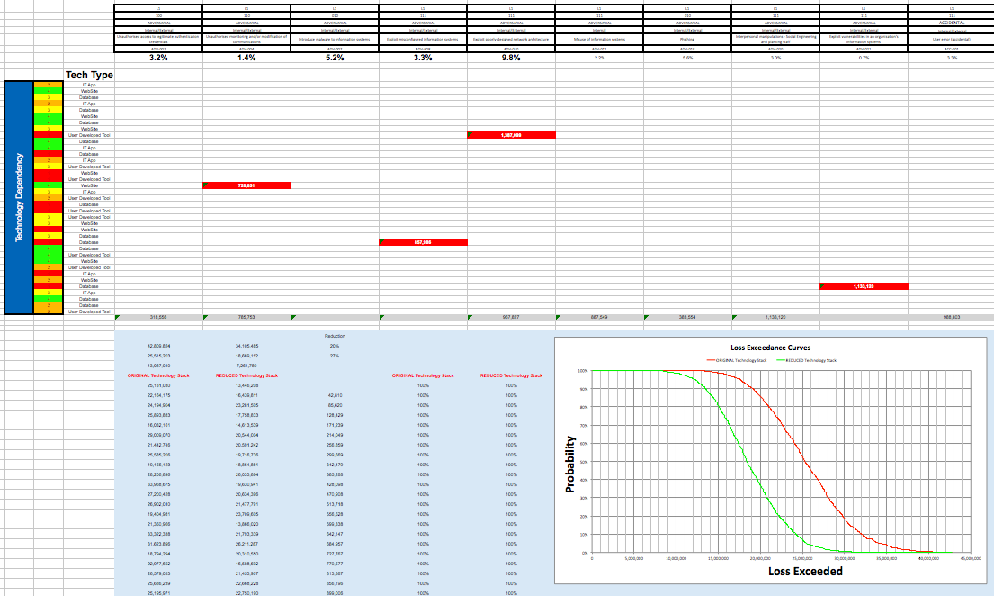
6th Model Residual Risk (1)
(Fewer) Relised Risk Event ($)
Monte Carlo simulation
Loss Exceedance

Slide 33
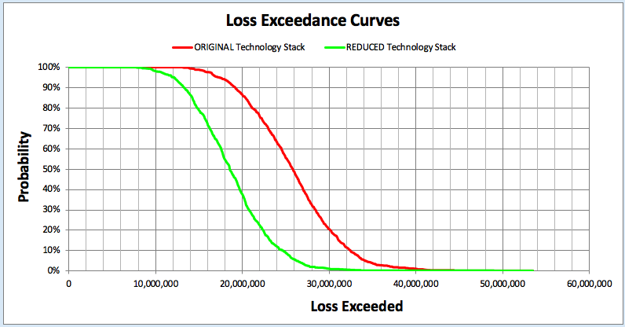
6th Model Residual Risk (1)
Expected Loss £19m
Notes:
90% probability of losses exceeding £13m
30% probability of losses exceeding £21m
10% probability of losses exceeding £24m
Expected Loss £19m

Slide 34
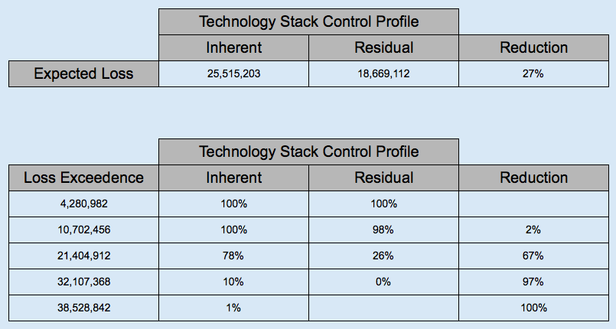
7th See the £difference
Significant Risk materially reduced

Slide 35
What we're doing now
Where next
What we were brought in to do
What we were doing
Where we're going
...and after that
Notes:
Re-running Realised Risk analysis for year to July 2018 to inform threat profile
Commencing programme of QRAs on Investments business product

Slide 36
What we're doing now
Where next
What we were brought in to do
What we were doing
Where we're going
...and after that
Notes:
Challenge Cybersecurity program to justify investment in business terms i.e. £.

