Slide 1

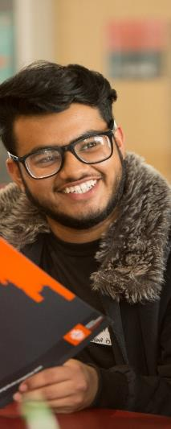
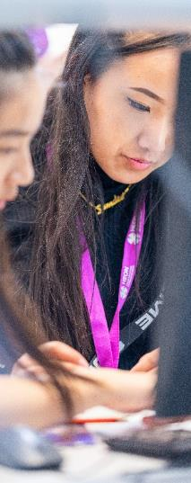
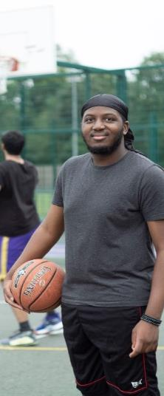
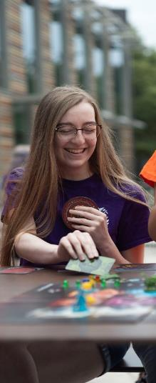
Royal Holloway Spring University
21 – 23 April 2026
Notes:
Any Questions?

Slide 2

What?
3 days, 2 nights
Subject taster sessions
Meet current uni students
Lots of social activities
All food provided
Completely free
Notes:
Student Unions are a student-led organization, independent from the university, that represents the interests and needs of its students.
Students' unions are run by reps elected by students, and they're responsible for representing you – so you can go to them for all kinds of support.
There organise a lot of the social activities and support Sports Clubs and societies that is run by students.

Slide 3
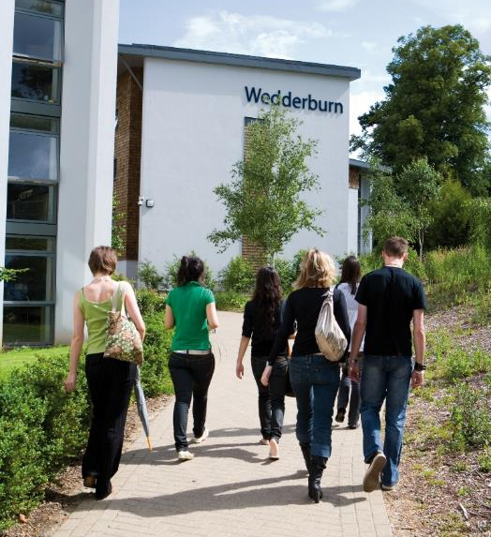
Where?
Royal Holloway
Beautiful Egham campus
Your own private bedroom
Ensuite shower & bathroom
Classrooms & laboratories
Cafes & restaurants
Notes:
Student Unions are a student-led organization, independent from the university, that represents the interests and needs of its students.
Students' unions are run by reps elected by students, and they're responsible for representing you – so you can go to them for all kinds of support.
There organise a lot of the social activities and support Sports Clubs and societies that is run by students.

Slide 4

When?
Arrive 21 April 2025 AM
Leave 23 April 2025 PM
Application deadline:
31 January 2026
Notes:
Student Unions are a student-led organization, independent from the university, that represents the interests and needs of its students.
Students' unions are run by reps elected by students, and they're responsible for representing you – so you can go to them for all kinds of support.
There organise a lot of the social activities and support Sports Clubs and societies that is run by students.

Slide 5
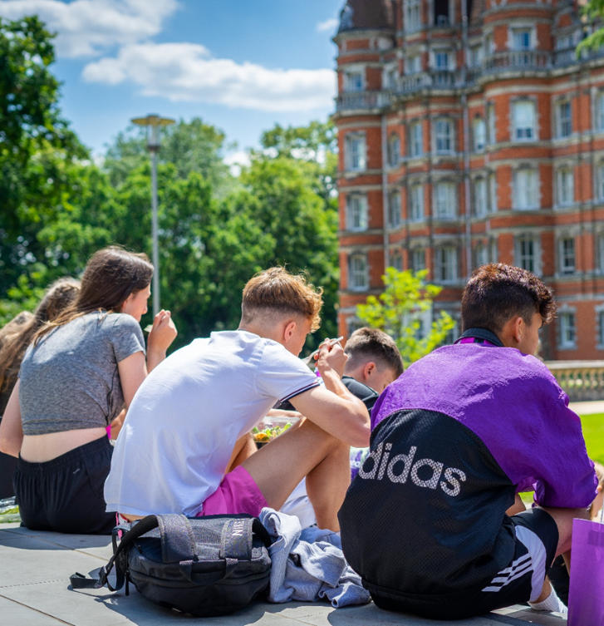
Who?
60 available places
For students from ‘Widening Access’ backgrounds
And us…!
Notes:
Student Unions are a student-led organization, independent from the university, that represents the interests and needs of its students.
Students' unions are run by reps elected by students, and they're responsible for representing you – so you can go to them for all kinds of support.
There organise a lot of the social activities and support Sports Clubs and societies that is run by students.

Slide 6
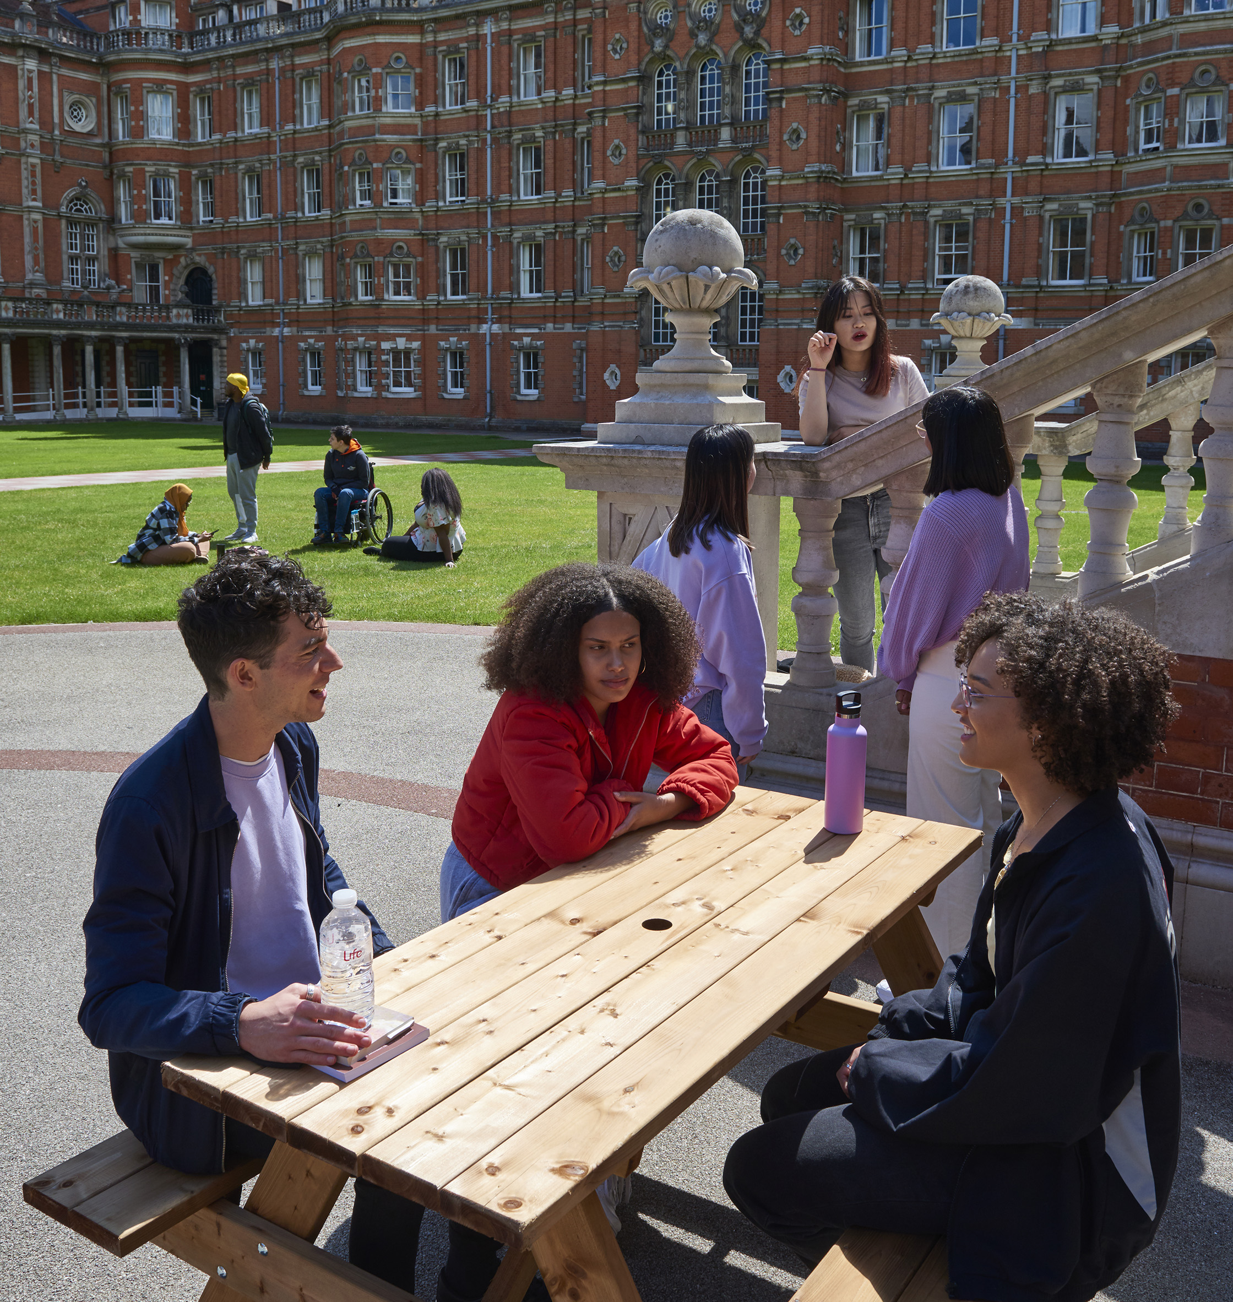
Why?
To have fun!
Meet new people
See what uni is like
See all your options
Help with studies
Notes:
Student Unions are a student-led organization, independent from the university, that represents the interests and needs of its students.
Students' unions are run by reps elected by students, and they're responsible for representing you – so you can go to them for all kinds of support.
There organise a lot of the social activities and support Sports Clubs and societies that is run by students.

Slide 7


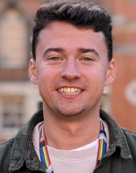



Meet the team
Gina
WA Manager
Jonathan
HEON Officer
James
WA Officer
Ebony
WA Officer
Emilia
Data & Evaluation Officer
Joe
WA Officer
Notes:
Student Unions are a student-led organization, independent from the university, that represents the interests and needs of its students.
Students' unions are run by reps elected by students, and they're responsible for representing you – so you can go to them for all kinds of support.
There organise a lot of the social activities and support Sports Clubs and societies that is run by students.

Slide 8
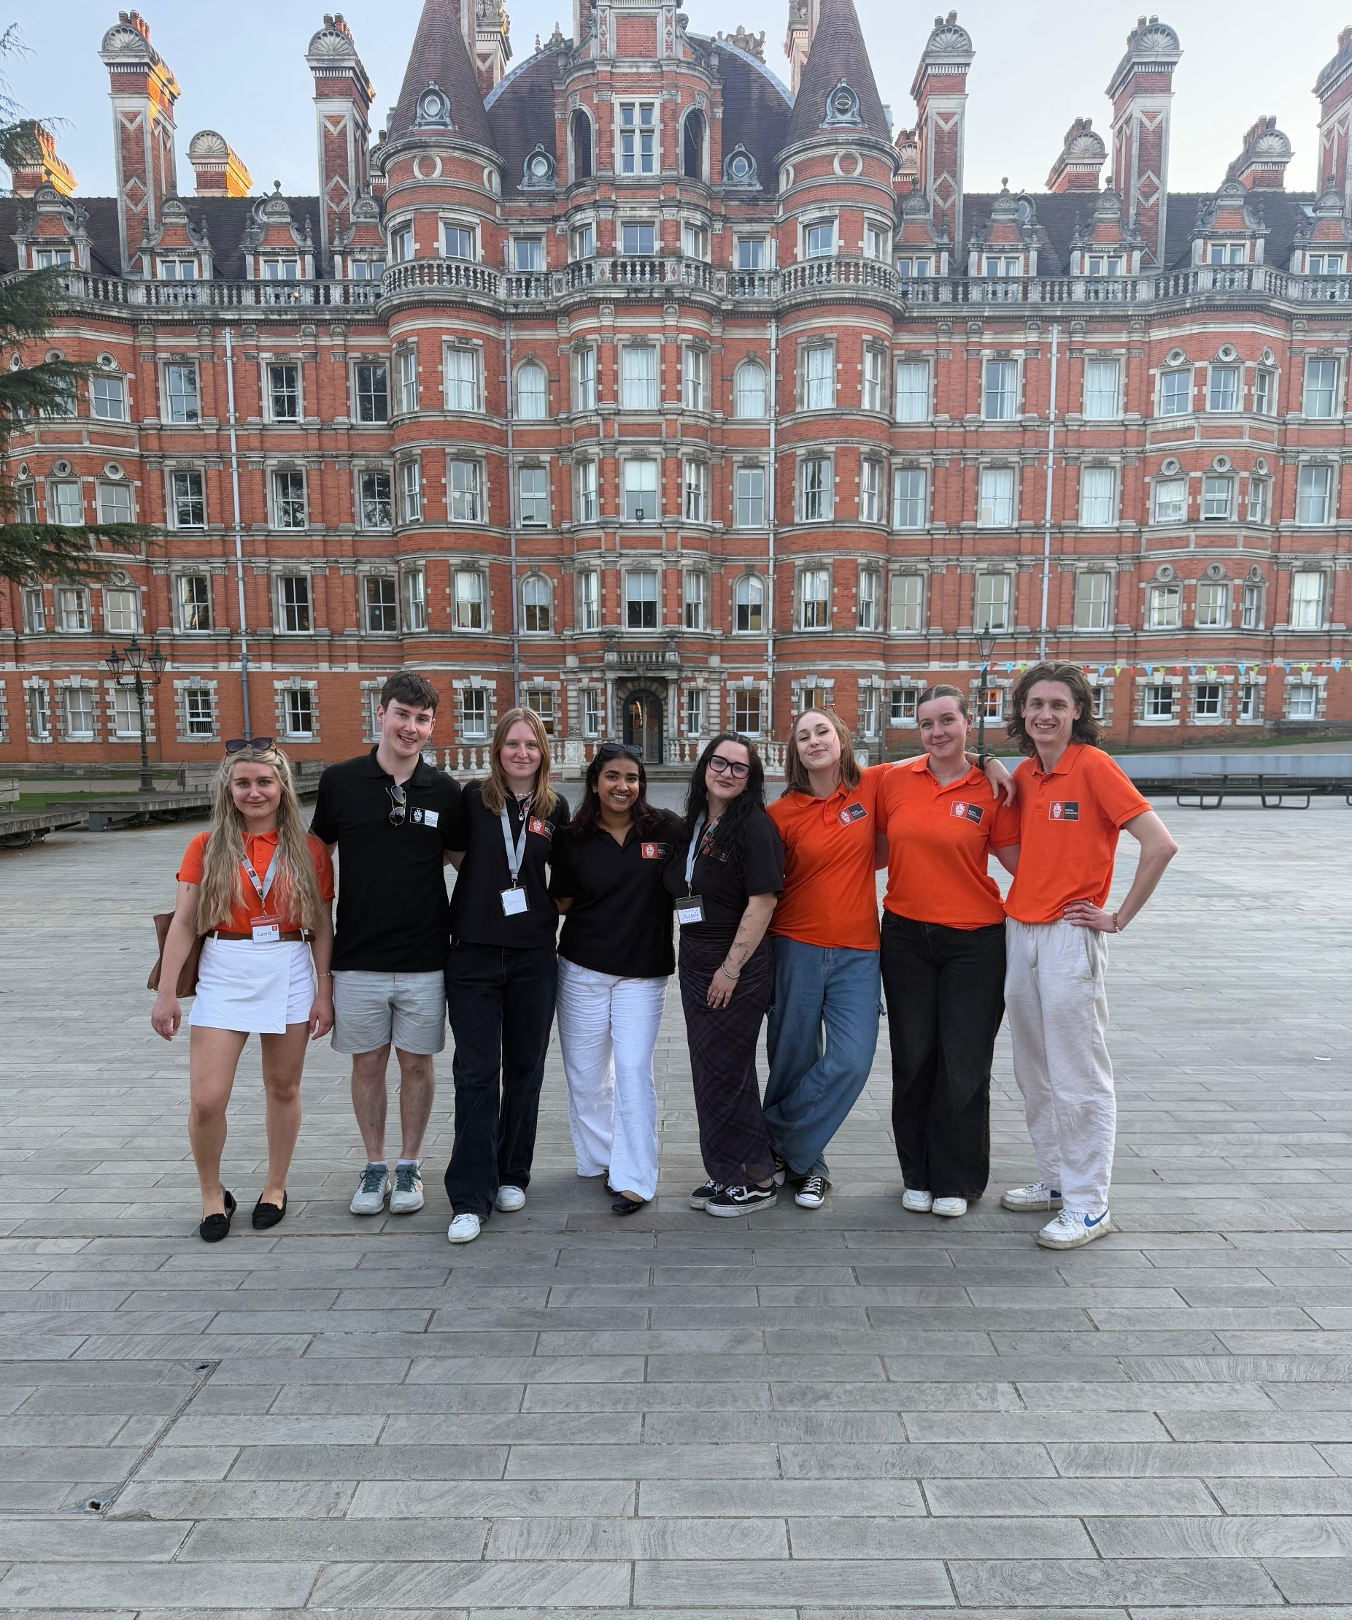
Our amazing Student Ambassadors (currently studying at Royal Holloway) will be with us the whole time
Notes:
Any Questions?

Slide 9
Applications
You will need to include information about yourself, your parents/guardians, and one of your teachers
Be honest, double check your answers, and speak to your teacher and parents/guardians first
For more information on eligibility go to ‘Who can apply?’ on the Spring University webpage

Slide 10




@royal_holloway
@royalholloway
@RoyalHollowayUoL
Spring University: 21 – 23 April 2026 at Royal Holloway
For year 10s and 11s
Scan QR Code for more information
Notes:
Any Questions?

